Slide 1


Arrays
Processing Sequences of Elements
Firomsa Wakjira
Windows Programming

Slide 2

Table of Contents
Declaring and Creating Arrays
Accessing Array Elements
Console Input and Output of Arrays
Iterating Over Arrays Using for and foreach
Matrices and Multidimensional Arrays
Dynamic Arrays
  Lists<T>
→
Copying Arrays

Slide 3

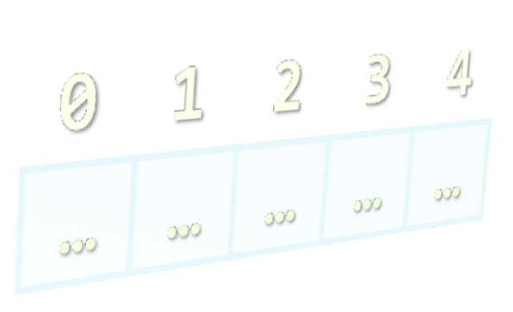

Declaring and Creating Arrays

Slide 4

What are Arrays?
An array is a sequence of elements
  All elements are of the same type
  The order of the elements is fixed
  Has fixed size (Array.Length)
Element of an
array
0 1 2 3 4
Element index
Array of 5 elements
… … … … …

Slide 5

Declaring Arrays
Declaration defines the type of the elements
Square brackets [] mean "array"
Examples:
  Declaring array of integers:
int[] myIntArray;
Declaring array of strings:
string[] myStringArray;

Slide 6

Creating Arrays
Use the operator new
  Specify array length
Example creating (allocating) array of 5 integers:
myIntArray = new int[5];
 | 0 | 1 | 2 | 3 | 4
myIntArray | … | … | … | … | …
managed heap (dynamic memory)

Slide 7
Creating and Initializing Arrays
Creating and initializing can be done together:
myIntArray = {1, 2, 3, 4, 5};
 | 0 | 1 | 2 | 3 | 4
myIntArray | … | … | … | … | …
managed heap (dynamic memory)
The new operator is not required when using curly brackets initialization

Slide 8

Creating Array – Example
Creating an array that contains the names of the days of the week
string[] daysOfWeek =
{
"Monday",
"Tuesday",
"Wednesday",
"Thursday",
"Friday",
"Saturday",
"Sunday"
};

Slide 9



Days of Week
Live Demo

Slide 10

Accessing Array Elements
Read and Modify Elements by Index

Slide 11
How to Access Array Element?
Array elements are accessed using the square brackets operator [] (indexer)
  Array indexer takes element’s index as parameter
  The first element has index 0
  The last element has index Length-1
Array elements can be retrieved and changed by the [] operator

Slide 12
Reversing an Array – Example
Reversing the contents of an array
int[] array = new int[] { 1, 2, 3, 4, 5 };
// Get array size
int length = array.Length;
// Declare and create the reversed array
int[] reversed = new int[length];
// Initialize the reversed array
for (int index = 0; index < length; index++)
{
reversed[length - index - 1] = array[index];
}

Slide 13
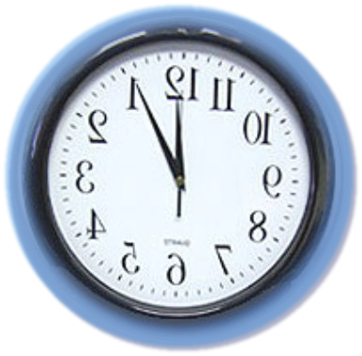


Reversing an Array
Live Demo

Slide 14

Arrays: Input and Output
Reading and Printing Arrays on the Console

Slide 15
Reading Arrays From the
Console
First, read from the console the length of the array
int n = int.Parse(Console.ReadLine());
Next, create the array of given size and read its elements in a for loop
int[] arr = new int[n];
for (int i = 0; i < n; i++)
{
arr[i] = int.Parse(Console.ReadLine());
}

Slide 16
Symmetry Check – Example
Read int array from the console and check if it is symmetric:
1 2 2 1 1 2 3 2 1 1 2 3 3 2 1
bool isSymmetric = true;
for (int i = 0; i <(array.Length + 1)/2; i++)
{
if (array[i] != array[n - i - 1])
{
isSymmetric = false;
}
}

Slide 17

Symmetry Check
Live Demo

Slide 18
Printing Arrays on the Console
Process all elements of the array
Print each element to the console
Separate elements with white space or a new line
string[] array = {"one", "two", "three"};
// Process all elements of the array
for (int index = 0; index < array.Length; index++)
{
// Print each element on a separate line
Console.WriteLine("element[{0}] = {1}",index, array[index]);
}

Slide 19

Printing Arrays
Live Demo

Slide 20
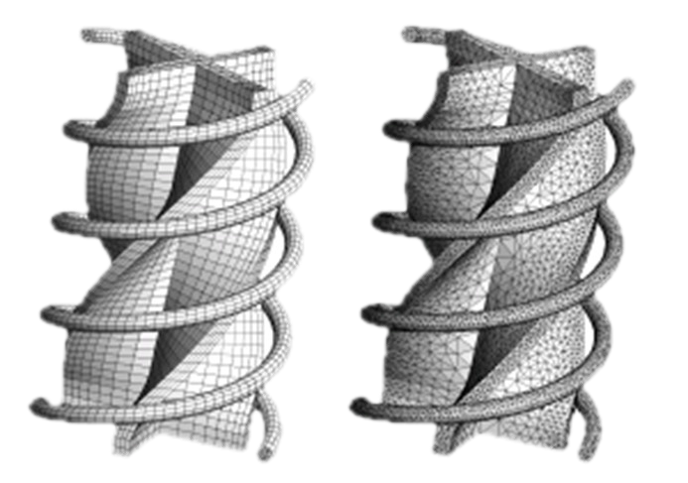
Processing Array Elements Using for and foreach

Slide 21
Processing Arrays: for Statement
Use for loop to process an array when
  Need to keep track of the index
  Processing is not strictly sequential from the first to the last element
In the loop body use the element at the loop index (array[index]):
for (int index = 0; index < array.Length; index++)
{
squares[index] = array[index] * array[index];
}

Slide 22
Processing Arrays Using for
Loop – Examples
Printing array of integers in reversed order:
Console.WriteLine("Reversed: ");
for (int i = array.Length - 1; i >= 0; i--)
{
Console.Write(array[i] + " ");
}
// Result: 5 4 3 2 1
Initialize all array elements with their corresponding index number:
for (int index = 0; index < array.Length - 1; index++)
{
array[index] = index;
}

Slide 23

Processing Arrays: foreach
How foreach loop works?
foreach (type value in array)
type – the type of the element
value – local name of variable
array – processing array
Used when no indexing is needed
  All elements are accessed one by one
  Elements can not be modified (read only)

Slide 24
Processing Arrays Using
foreach – Example
Print all elements of a string[] array:
string[] capitals =
{
"Sofia",
"Washington",
"London",
"Paris"
};
foreach (string capital in capitals)
{
Console.WriteLine(capital);
}

Slide 25

Processing Arrays
Live Demo

Slide 26
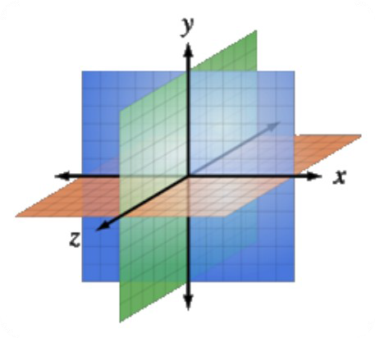
Multidimensional Arrays
Using Array of Arrays, Matrices and Cubes

Slide 27
What is Multidimensional Array?
Multidimensional arrays have more than one dimension (2, 3, …)
  The most important multidimensional arrays are the 2-dimensional
    Known as matrices or tables
Example of matrix of integers with 2 rows and 4 columns:
 | 0 | 1 | 2 | 3
0 | 5 | 0 | -2 | 4
1 | 5 | 6 | 7 | 8

Slide 28
Declaring and Creating Multidimensional Arrays
Declaring multidimensional arrays:
int[,] intMatrix;
float[,] floatMatrix;
string[, ,] strCube;
Creating a multidimensional array
  Use new keyword
  Must specify the size of each dimension
int[,] intMatrix = new int[3, 4];
float[,] floatMatrix = new float[8, 2];
string[, ,] stringCube = new string[5, 5, 5];

Slide 29
Initializing Multidimensional
Arrays with Values
Creating and initializing with values multidimensional array:
int[,] matrix =
{
{1, 2, 3, 4}, //row 0 value
{5, 6, 7, 8}, //row 1 value
};//The matrix size is 2 x 4(2 rows and 4 cols)
Matrices are represented by a list of rows
  Rows consist of list of values
The first dimension comes first, the second comes next (inside the first)

Slide 30
Accessing The Elements of Multidimensional Arrays
Accessing N-dimensional array element:
nDimensionalArray[index1, … , indexn]
Getting element value example:
int[,] array = {{1, 2}, {3, 4}}
int element11 = array[1, 1]; //element11 = 4
Setting element value example:
Number of rows
int[,] array = new int[3, 4];
for (int row = 0; row < array.GetLength(0); row++)
for (int col = 0; col < array.GetLength(1); col++)
array[row, col] = row + col;
Number of cols

Slide 31
Reading Matrix – Example
Reading a matrix from the console
int rows = int.Parse(Console.ReadLine());
int columns = int.Parse(Console.ReadLine());
int[,] matrix = new int[rows, columns];
String inputNumber;
for (int row = 0; row < rows; row++)
{
for (int column = 0; column < columns; column++)
{
Console.Write("matrix[{0},{1}] = ", row, column);
inputNumber = Console.ReadLine();
matrix[row, column] = int.Parse(inputNumber);
}
}

Slide 32
Printing Matrix – Example
Printing a matrix on the console:
for (int row = 0; row < matrix.GetLength(0); row++)
{
for (int col = 0; col < matrix.GetLength(1); col++)
{
Console.Write("{0} ", matrix[row, col]);
}
Console.WriteLine();
}

Slide 33

Reading and Printing Matrices
Live Demo

Slide 34
Maximal Platform – Example
Finding a 2 x 2 platform in a matrix with a maximal sum of its elements
int[,] matrix = { {7,1,3,3,2,1},
{1,3,9,8,5,6},
{4,6,7,9,1,0}
};
int bestSum = int.MinValue;
for (int row = 0; row < matrix.GetLength(0) - 1; row++)
for (int col = 0; col < matrix.GetLength(1) - 1; col++)
{
int sum = matrix[row, col] + matrix[row, col +1] +
matrix[row + 1, col] + matrix[row + 1, col + 1];
if (sum > bestSum)
bestSum = sum;
}
Console.WriteLine(bestSum);

Slide 35
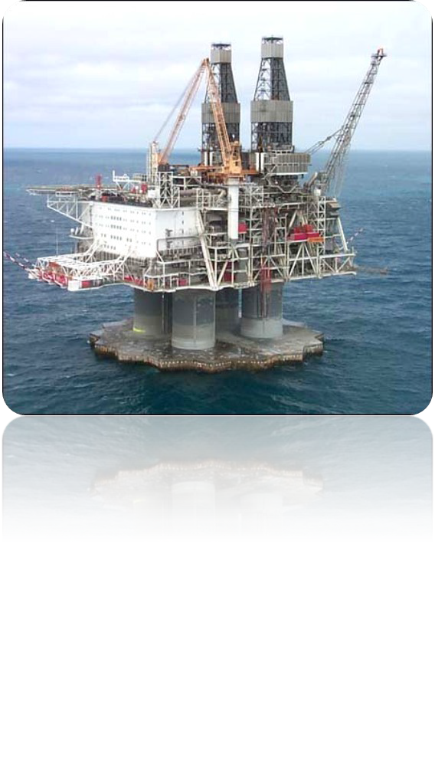
Maximal Platform
Live Demo

Slide 36
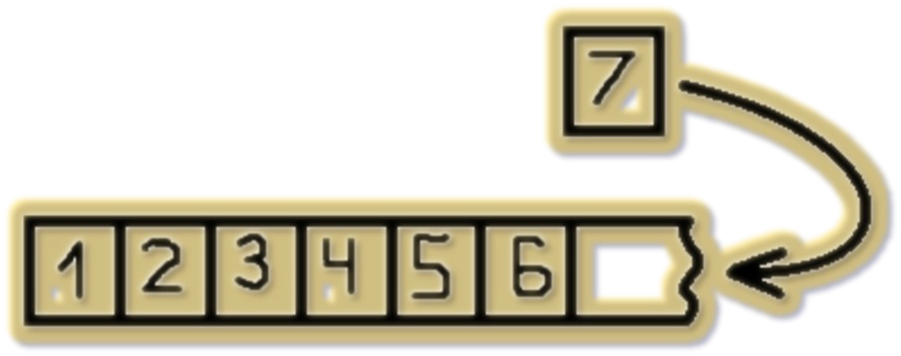


Dynamic Arrays
List<T>

Slide 37
Lists
Lists are arrays that resize dynamically
  When adding or removing elements
  Also have indexers ( like Array)
  T is the type that the List will hold
    E.g. List<int> will hold integers
    List<object> will hold objects
Basic Methods and Properties
  Add(T element) – adds new element to the end
  Remove(element) – removes the element
  Count – returns the current size of the List

Slide 38
List Example
List<int> intList = new List<int>();
for (int i = 0; i < 5; i++)
{
intList.Add(i);
Console.WriteLine(intList[i]);
}
Is the same as
int[] intArray = new int[5];
for (int i = 0; i < 5; i++)
{
intArray[i] = i;
Console.WriteLine(intArray[i]);
}
The main difference
  When using lists we don't have to know the exact number of elements
38

Slide 39
Lists vs. Arrays
Lets have an array with capacity of 5 elements
int[] intArray=new int[5];
If we want to add a sixth element ( we have already added 5) we have to do
int[] copyArray = intArray;
intArray = new int[6];
for (int i = 0; i < 5; i++)
{
intArray[i] = copyArray[i];
}
intArray[5] = newValue;
With List we simply do
list.Add(newValue);
39

Slide 40


Lists <T>
Live Demo
40

Slide 41
Copying Arrays
The Array Class

Slide 42
Copying Arrays
Sometimes we must copy the values from one array to another one
  If we do it the intuitive way we would copy not only the values but the reference to the array
    Changing some of the values in one array will affect the other
int[] copyArray=array;
The way to avoid this is using Array.Copy()
Array.Copy(sourceArray, copyArray);
This way only the values will be copied but not the reference

Slide 43
Summary
Arrays are a fixed-length sequences of elements of the same type
Array elements are accessible by index
  Can be read and modified
Iteration over array elements can be done with
for and foreach loops
Matrices (2-dimensional arrays) are very useful for presenting tabular data

Slide 44





Arrays
Questions?

Slide 45
Exercises
Write a program that allocates array of 20 integers and initializes each element by its index multiplied by 5. Print the obtained array on the console.
Write a program that reads two arrays from the console and compares them element by element.
Write a program that compares two char arrays lexicographically (letter by letter).
Write a program that finds the maximal sequence of equal elements in an array.
Example: {2, 1, 1, 2, 3, 3, 2, 2, 2, 1} → {2, 2, 2}.

Slide 46
Exercises (2)
Write a program that finds the maximal increasing sequence in an array. Example:
{3, 2, 3, 4, 2, 2, 4} → {2, 3, 4}.
Write a program that reads two integer numbers N and K and an array of N elements from the console. Find in the array those K elements that have maximal sum.
Sorting an array means to arrange its elements in increasing order. Write a program to sort an array. Use the "selection sort" algorithm: Find the smallest element, move it at the first position, find the smallest from the rest, move it at the second position, etc.

Slide 47
Exercises (3)
1. Write a program that finds the sequence of maximal sum in given array. Example:
{2, 3, -6, -1, 2, -1, 6, 4, -8, 8} → {2, -1, 6, 4}
Can you do it with only one loop (with single scan through the elements of the array)?
4. Write a program that finds the most frequent number in an array. Example:
44
44
44
44
44
, 9, 3} → 4 (5 times)
{ , 1, 1, , 2, 3, , , 1, 2,
a
Write a program that finds in given array of integers
a sequence of given sum S (if present). Example:
44,, 22,, 55
{4, 3, 1,
, 8}, S=11 → {4, 2, 5}

Slide 48
Exercises (4)
1. Write a program that fills and prints a matrix of size (n, n) as shown below: (examples for n = 4)
1 | 5 | 9 | 13
2 | 6 | 10 | 14
3 | 7 | 11 | 15
4 | 8 | 12 | 16
1 | 8 | 9 | 16
2 | 7 | 10 | 15
3 | 6 | 11 | 14
4 | 5 | 12 | 13
a)
b)
7 | 11 | 14 | 16
4 | 8 | 12 | 15
2 | 5 | 9 | 13
1 | 3 | 6 | 10
1 | 12 | 11 | 10
2 | 13 | 16 | 9
3 | 14 | 15 | 8
4 | 5 | 6 | 7
c)
d)

