Slide 1
AMBO UNIVERSITY WOLISO CAMPUS
SCHOOL OF BUSINESS AND ECONOMICS
DEPARTMENT OF MANAGEMENT
Course Title: Organizational Bahaviour (OB)
Corse Code: MGMT4114
Students Department: Information System
Academic Year : 2019/20 G.C (2012 E.C)
Semester: II
Prepared By : NEGA E. ( MBA)

Slide 2
Chapter 1
An Overview of Organizational Behavior
Definitions of Organizational Behavior(OB)
Organizational behavior is a scientific discipline in which a large number of research studies and conceptual developments are constantly adding to its knowledge base.
It is also an applied science, in that information about effective practices in one organization is being extended to many others.

Slide 3
Cont’d
Organizational behavior is the study of human behavior, attitudes and performance within the organization setting; drawing on theory, methods, and principles from such disciplines as psychology, sociology, and cultural anthropology to learn about individual perceptions, values, learning capacities, and actions while working in groups and within the total organization; analyzing the external environment’s effect on the organization and its human resources, missions, objectives, and strategies.

Slide 4
Cont’d
Organizational behavior is an interdisciplinary field dedicated to better understanding and managing people at work.
Organizational behavior (often abbreviated OB) is a field of study that investigates the impact that individuals, groups, and structure have on behavior within organizations, for the purpose of applying such knowledge toward improving an organization’s effectiveness

Slide 5
The three basic units of analysis in OB
1. Behavior of individuals within the organizations.
2. Dynamics of relationships within small groups both formal teams and informal groups.
3. Whole systems that have inter-organizational relationships

Slide 6
Replacing Intuition with systematic Study
Many of the views you hold concerning human behavior are based on intuition rather than fact.
As a result, a systematic approach to the study of behavior can improve your explanatory and predictive abilities.

Slide 7
Characteristics of Organizational Behavior
Its interdisciplinary nature.
uses scientific methods to develop and empirically test generalizations about behavior in the organizations.
focuses on applications and seeks relevancy in answering practical questions relating to human behavior in organization.
uses contingency thinking in its search for ways to improve up on these outcomes.

Slide 8
Contributing Disciplines to Organizational Behavior (OB)
Following are some of the major contributing disciplines to the study of organizational behavior:
Psychology
Sociology
Social Psychology
Anthropology

Slide 9
Ethics and Organizational Behavior
With the pattern of organizational behavior (OB), injustice, corporate dishonesty, exploitation, negligence and others being more visible and attracting public opinion and criticism, and hence ethical violations are carefully avoided.
So, organizational behavior is important for creating ethical organization and avoid unethical business practices.

Slide 10
Organization as a system
Organizational components that need to be managed are: People, Structure, Culture, Technology, Jobs, etc.
Therefore, organization is a system having many interrelated components that interact each to achieve common goals.

Slide 11
Reading Assignment
Management and OB in the 21st Century and Development of OB is your reading assignment.

Slide 12
Chapter 2
Foundation of Individual Behavior and Learning in an Organization
Perception
What is Perception?
Perception is the process by which individuals organize and interpret their sensory impressions in order to give meaning to their environment.

Slide 13
Why Perception is important?
- Because people’s behavior is based on their perception of what reality is, not on reality itself.
- Because the world as it is perceived is the world that is behaviorally important.
- Because perception is used to better understand how people make attributions about events.
- Because we don’t see reality. But, we interpret what we see and call it reality.
- Because the attribution process guides our behavior, regardless of the truth of the attribution.

Slide 14
Factors Influencing Perception
These factors can reside in :
The perceiver,
In the object or target being perceived, or
In the context of the situation in which the perception is made.

Slide 15
Perceptual Errors
Attribution problem - there are two attribution theories:
a) Fundamental Attribution Error:- The tendency to underestimate external factors and overestimate internal factors when making judgments about others’ behavior.
b) Self-Serving Bias: - The tendency to attribute one’s successes to internal factors while putting the blame for failures on external factors.
Selective Perception :- People selectively interpret what they see based on their interests, background, experience, and attitudes.
Halo Effect :- Drawing a general impression about an individual based on a single characteristic.

Slide 16
Cont’d
Contrast Effects -A person’s evaluation is affected by comparisons with other individuals recently encountered.
Projection - Attributing one’s own characteristics to other people.
- Stereotyping - Judging someone on the basis of your perception of the group to which that person belongs.
- Prejudice -An unfounded dislike of a person or group based on their belonging to a particular stereotyped group.
- Self-Fulfilling Prophecy - A concept that proposes a person will behave in ways consistent with how he or she is perceived by others.

Slide 17
Attitude
Attitude is evaluative statements or judgments concerning objects, people, or events. Attitudes are evaluative statements- either favorable or unfavorable- concerning objects, people, or events.

Slide 18
Components of Attitude
There are three components of attitude:
Cognitive component :- an opinion is the cognitive component of an attitude.
Affective component:- is the emotional or feeling segment of an attitude.
Behavioral component :- an attitude refers to an intention to behave in a certain way toward someone or something

Slide 19
Sources of Attitudes
Attitudes are acquired from parents, teachers, peer group members and so forth.
People also imitate the attitudes of popular individuals and those they admire and respect.
In contrast to values, your attitudes are less stable.
Advertising messages, for example, attempt to alter your attitudes toward a certain product or service.

Slide 20
Characteristics and formation of Attitude
Many of the attitudes of the individual have their source and support in groups with which the individual comes in alliance.
His attitudes tend to reflect the beliefs, values and the norms of his group, and to maintain his attitude the individual must have the support of his group.
The group helps in the foundation of attitudes.

Slide 21
Types of Attitudes
Most of the research in organizational behaviour has been concerned with the following attitudes:
- job satisfaction, job involvement, organizational commitment, employee engagement, and perceived organizational support.

Slide 22
Predicting Behavior from Attitudes
Important attitudes have a strong relationship to behavior.
Specific attitudes predict specific behavior.
General attitudes predict general behavior.
The more frequently expressed an attitude, the better predictor it is.
High social pressures reduce the relationship and may cause dissonance.
Attitudes based on personal experience are stronger predictors.

Slide 23
Consistency of Attitudes
People seek consistency among their attitudes and their behavior.
When there is an inconsistency, the individual may alter either the attitudes or behavior, or develop a rationalization for the discrepancy.
Did you ever notice how people change what they say so it doesn't contradict what they do?

Slide 24
Personality
What is Personality?
- Personality is "the dynamic organization within the individual of those psychophysical systems that determine his unique adjustments to his environment.
For our purposes, you should think of personality as the sum total of ways in which an individual reacts and interacts with others. This is most often described in terms of measurable personality traits that a person exhibits.
Personality is the sum total of ways in which an individual reacts.

Slide 25
Personality Determinants
Personality is now generally considered to be made up of both:
Hereditary factors ( Nature)
Environmental factors (Nurture)

Slide 26
Major Personality Attributes Influencing OB.
1. LOCUS OF CONTROL :-Some people believe they are masters of their own fate.
Internals:- those who believe they control their destinies.
Externals:- those who see their lives as being controlled by outside forces, have been called externals.

Slide 27
2. Machiavellianism (Mach):-
An individual high in Machiavellianism is pragmatic, maintains emotional distance, and believes that ends can justify means. "If it works, use it"
High-Machs manipulate more, win more, are persuaded less, and persuade others more than do low-Machs.
Jobs/responsibilities for high Mach: labor negotiation, commissioned sales, etc.
Jobs for low Mach:jobs not involving large interaction

Slide 28
3. SELF ESTEEM :- People differ in the degree to which they like or dislike themselves.
-High-self esteems believe they possess more of the ability they need in order to succeed at work.
Jobs for high self esteems:- Individuals with high self esteem will take more risks in job selection and are more likely to choose unconventional Jobs than people with low self esteem.
Jobs for low self esteems: conventional jobs

Slide 29
4. SELF-MONITORING:-It refers to an individual's ability to adjust his or her behavior to external, situational factors.
They are highly sensitive to external cues and can behave differently in different situations.
Jobs for high self monitoring: We might also hypothesize that high self-monitors will be more successful in managerial positions where individuals are required to play multiple, and even contradicting roles.
Jobs for low self monitoring:-customer service.

Slide 30
5. RISK TAKING - People differ in their willingness and propensity to take or avoid risks.
- Jobs for high risk taking propensity: high risk- taking propensity may lead to more effective performance for a stock trader in a brokerage firm because this type of job demands rapid decision making.
On the other hand, this personality characteristic might prove a major obstacle to an accountant who performs auditing activities. For such activity low risk takers may be recommended.

Slide 31
6. Type A personality - Aggressive involvement in a chronic, incessant struggle to achieve more and more in less and less likely and, if necessary, against the opposing efforts of other things or other people.
Moreover Type A's are:
1. are always moving, walking, and eating rapidly;
2. feel impatient with the rate at which most events take place;
3. strive to think or do two or more things simultaneously;
4. cannot cope with leisure time; and
5. Are measuring their success in terms of how much of everything they acquire.( quantity)

Slide 32
Type B’s are:
1.never suffer from a sense of time urgency with its accompanying impatience;
2. feel no need to display or discuss, either their achievements or accomplishments unless such exposure is demanded by the situation;
3. play for fun and relaxation, rather than to exhibit their superiority at any cost; and
4. can relax and sufficient time,
5. Focus on quality, etc

Slide 33
Learning
Learning:- is any relatively permanent change in behavior that occurs as a result of experience.
-We can see changes taking place, but not the learning itself.
- In other words, we infer that learning has taken place if an individual behaves, reacts, responds as a result of experience in a manner different from the way he formerly behaved.

Slide 34
Types and Theories of Learning
There are three theories of learning:
1. Classical conditioning: developed by Ivan Pavlov.
When Pavlov presented the dog with a piece of meat, the dog exhibited a noticeable increase in salivation.
When Pavlov withheld the presentation of meat and merely rang a bell, the dog had no salivation.
Then Pavlov proceeded to link the meat and the ringing of the bell. After repeatedly hearing the bell before getting the food, the dog began to salivate as soon as the bell rang.
After a while, the dog would' salivate merely at the sound of the bell, even if no food was offered. In effect, the dog had learned to respond-that is, to salivate-to the bell.

Slide 35
In an organizational setting, we can also see classical conditioning operating. For example, at one manufacturing plant, every time the top executives from the head office were scheduled to visit, the plant management would clean up the administrative offices and wash the windows.
This went on for years. Eventually, employees would turn on their best behavior and look formal and proper whenever the windows were cleaned-even in those occasional instances when the cleaning was not paired with the visit from the top brass.
People had learned to associate the cleaning of the windows with the visit from the head office.

Slide 36
2. OPERANT CONDITIONING – developed by skinner.
- Operant conditioning argues that behavior is a function of its consequences.
- People learn to behave to get something they want or avoid something they don't want.
Skinner argued that by creating pleasing consequences to follow specific forms of behavior, the frequency of that behavior will increase.
People will most likely engage in desired behaviors if they are positively reinforced for doing so
Rewards, for example, are most effective if they immediately follow the desired response. Additionally, behavior that is not rewarded, or is punished, is less likely to be repeated.

Slide 37
Positive reinforcement:- such as praise , thanks, thank you letter, bonus, etc.
Negative reinforcement:- removal of warning, ignoring attendance, etc.
- Positive Vs Negative reinforcement (This is Your reading assignment)

Slide 38
3. SOCIAL LEARNING – developed by A.Bandura
Individuals can also learn by observing what happens to other people and just by being told about something, as well as by direct experiences.
So, for example, much of what we have learned comes from watching models-parents, teachers, peers, motion picture and television performers, bosses, and so forth.
This view that we can learn through both observation and direct experience has been called social-learning theory.

Slide 39
CHAPTER 3
FOUNDATION OF GROUP BEHAVIOR
Defining and Classifying Group
- A group is defined as two or more individuals, interacting and interdependent, who have come together to achieve particular objectives.
-A group is two or more people who interact with each other to accomplish certain goals or meet certain needs.

Slide 40
Which benefits an organization more?
when employees work as individual? or
when employees work as group?
Organizations benefit more when employees work or perform as a group or team because of synergy advantage.

Slide 41
What is the difference between team and group?
- A group is any member of people who interact with one another, are psychologically aware of one another and perceive themselves to be a group.
- A work group is a collection of people who share most, is not all, of the following characteristics: a definable membership, group consciousness, a sense of shared purpose, interdependence, interaction, and ability to act in a unitary manner

Slide 42
Team - A group whose members work intensely with each other to achieve a specific, common goal or objective.
  All teams are groups but not all groups are teams.
  Teams often are difficult to form.
  It takes time for members to learn how to work together.
Two characteristics distinguish teams from groups
  Intensity with which team members work together
  Presence of a specific, overriding team goal or objective

Slide 43
Groups’ and Teams’ Contributions to Organizational Effectiveness
      Enhance performance
      Increase responsiveness to customers
      Increase innovation
      Increase motivation and satisfaction, etc.

Slide 44
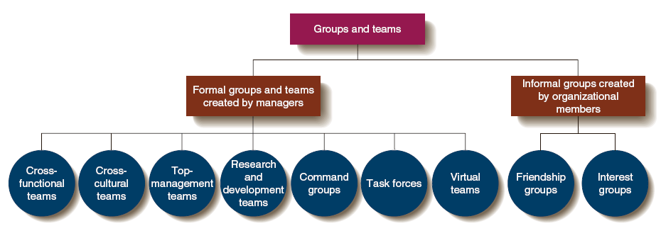
Types of Groups and Teams in Organizations

Slide 45
Groups can be either formal or informal
By formal groups, we mean those defined by the organization's structure, with designated work assignments/establishing tasks.
In the formal groups, the behaviors that one should engage in are stipulated by and directed toward organizational goals.
Examples are: mediating group, policy making group, task force/work group, command group, problem solving group, etc

Slide 46
informal groups are alliances that are neither formally structured nor organizationally determined.
These groups are natural formations in the work environment that appear in response to the need for social contact.
Example is three employees from different departments who regularly eat lunch together are an example of an informal group, interest group, friendship group, etc.

Slide 47
Which one of the following is important for the organization?
Formal groups or informal groups.

Slide 48
Group Size
Small groups
Advantages
  Interact more with each other and easier to coordinate their efforts
  More motivated, satisfied, and committed
  Easier to share information
  Better able to see the importance of their personal contributions, etc

Slide 49
Disadvantages:
Limited knowledge, skill, and experience
High work load, etc

Slide 50
Group size cont ...
large groups
Advantages:
      - More resources at their disposal to achieve group goals
      Enables managers to obtain division of labor advantages, etc
Disadvantages :
  Problem of communication and coordination
  Lower level of motivation
  Members might not think their efforts are really needed, etc

Slide 51
Why do people join group/team?
The following are some of the important reasons:
Security, Status , Self-Esteem, Affiliation - Groups can fulfill social needs, Power, Goal Achievement , Certain tasks can be performed only through the combined efforts of a number of individuals working together, collusion between members in order to modify formal working arrangements more to their liking, companionship and a source of mutual understanding and support from colleagues, etc

Slide 52
Stages of Group Development
There are two models of group development:
1.Five-stage model of group development, and
2. Punctuated-equilibrium model:- recently discovered model .it is your reading assignment.

Slide 53

Stages of group development cont…
The Five-Stage Model

Slide 54
Five stage model cont…
Forming:-
- The first stage, forming, is characterized by a great deal of uncertainty about the group's purpose, structure, and leadership.
-This stage is complete when members have begun to think of themselves as part of a group.

Slide 55
Five stage model cont…
Storming:-
-The storming stage is one of intra-group conflict.
Members accept the existence of the group, but resist the constraints the group imposes on individuality.
Further, there is conflict over who will control the group.
When this stage is complete, a relatively clear hierarchy of leadership exists within the group.

Slide 56
Five stage model cont…
Norming:-
-The third stage is one in which close relationships develop and the group demonstrates cohesiveness.
-There is now a strong sense of group identity and camaraderie.
- this stage is complete when correct member behavior is established.

Slide 57
Five stage model cont…
Performing:-
-The fourth stage is performing. The structure at this point is fully functional and accepted.
The group performs its duties.
For permanent work groups, performing is the last stage in their development.

Slide 58
Five stage model cont…
Adjourning stage:-
In this stage, the group prepares for its disbandment.
for temporary committees, teams, task forces, and similar groups that have a limited task to perform, there is an adjourning stage, which is the last stage.

Slide 59
Obstacles to team/group productivity
a. Free riders- free riders don’t participate in team efforts, but they expect to take credit for team success and receive a full share of team rewards.
b. dysfunctional team conflict- team can become dysfunctional if some take a personal dislike to others or engage in some other activity.
c. groupthink- it is a malady that happens when the team is intolerant of a healthy diversity of opinions.
d. insecure supervisors - many team initiatives are derailed by supervisors and managers who feel threatened by any proposed change.
e. disruptive high performers – disruptive high performers often cost the team more in terms of cohesiveness and total outcome than their special talents warrant, etc.

Slide 60
Group Norms:- the shared beliefs that regulate the behavior of team members are its team norms.
They represent the values and aspirations of the members.
Teams enforce norms with rewards and sanctions.
  Shared guidelines or rules for behavior that most group members follow
  Managers should encourage members to develop norms that contribute to group performance and the attainment of group goals

Slide 61
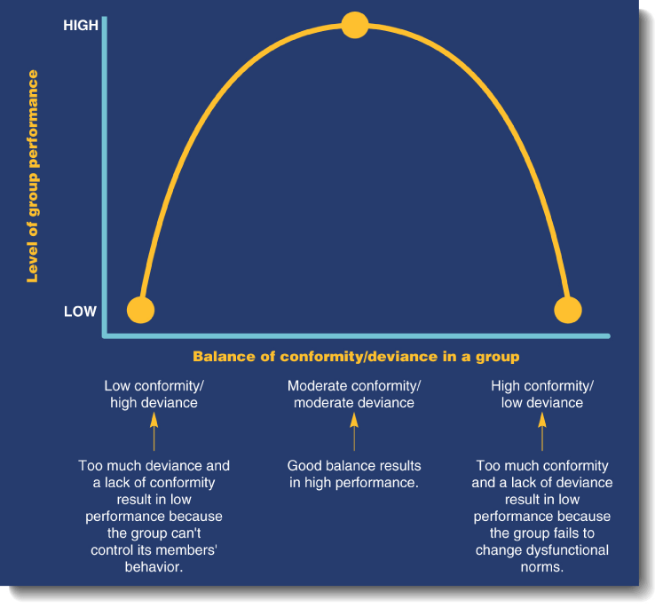
Conformity to group norms and Deviance from group norms

Slide 62
Conformity and deviance cont…
  Conformity and deviance must be balanced for high performance from the group.
  Deviance allows for new ideas in the group.
  Both extremes affect group performance

Slide 63
Group Cohesiveness: - the degree to which members are attracted to their group.
- The extent to which members feel a high degree of camaraderie, team spirit, and sense of unity is the degree of team cohesiveness.
Three major consequences
  Level of participation
  Level of conformity to group norms
  Emphasis on group goal accomplishment

Slide 64
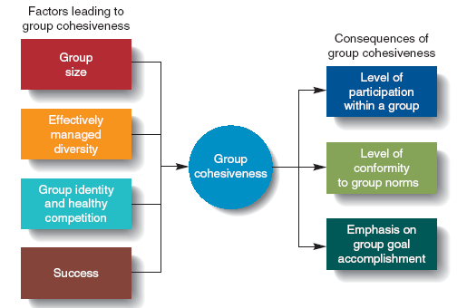
Sources and Consequences of Group Cohesiveness

Slide 65
Factors That Affect Group Cohesiveness
Agreement on group goals
Frequency of interaction
group size
Unpleasant experiences
Intergroup competition
Favorable evaluation
Domination by one or more members, etc

Slide 66
GROUP BEHAVIOR
- The group is individual’s creation and exists for the individual.
- An individual with other individuals comprise the bricks that make up the building which we call a group.
- A group behavior is not the sum total of the behaviors making the group but it is a unit rather than the components of the group.
An individual loses some of his individual personality traits and characteristics in the process of integration of effects of various individuals for efficient working. After transition has occurred, the individual’s personal bonds are changed and become mainly thoughts of the group.
Each individual is member of numerous groups. The groups like individuals have structural and integrative characteristics and operate in social environments.
The groups have power roles, leadership roles, communication and social structures. Groups have norms, ideologies, system, cohesiveness and morale. Individuals are greatly influenced by the powerful force of his group. The features or behavioral characteristics of effective teams are: cohesive with each other, select high performance norms, cooperative, exhibit interdependence, and trust one another.

Slide 67
CHAPTER 4
MOTIVATION CONCEPTS AND THEIR APPLICATIONS
What is Motivation?
Motivation is the willingness to exert high levels of effort toward organizational goals, conditioned by the efforts and ability to satisfy some individual need.
Motivation is concerned with effort toward any goal, we narrow the focus to organizational goals in order to reflect our singular interest in work-related behavior.

Slide 68
- Motivation refers to forces within an individual that account for the level, direction, and persistence of effort expended at work.
  Direction — an individual’s choice when presented with a number of possible alternatives.
  Level — the amount of effort a person puts forth.
  Persistence — the length of time a person stays with a given action.

Slide 69
Performance is the function of Ability, Motivation, Opportunity, Etc.
So motivation is important for performance.

Slide 70
Categories of Motivation Theories
  1. Content theories.
    Focus on profiling the needs that people seek to fulfill.
  2. Process theories.
    Focus on people’s thought or cognitive processes.
  3. Reinforcement theories.
  Emphasize controlling behavior by manipulating its consequences

Slide 71
1. Content Motivation Theories
Content theories assumes motivation results from the individual’s attempts to satisfy needs.
Major content theories of motivation are:
  Hierarchy of needs theory.
  ERG theory
  Acquired needs theory
  Two-factor theory
  Theory X and Theory Y

Slide 72
There are two categories of content theories of motivation:
I. Early Content Motivation Theories
- Hierarchy of Needs Theory
Theory X and Theory Y
Motivation-Hygiene Theory/Two-factor theory
        II. Contemporary Content theories of Motivation
        ERG Theory
        Acquired needs theory

Slide 73
I. Early Content Motivation Theories
A. Hierarchy of Needs Theory
It's probably safe to say that the most well-known theory of motivation is Abraham Maslow's hierarchy of needs.
He hypothesized that within every human being there exists a hierarchy of the following five needs:
1. Physiological: Includes hunger, thirst, shelter, sex, and other bodily needs
2. Safety: Includes security and protection from physical and emotional harm
3. Social: Includes affection, belongingness, acceptance, and friendship
4. Esteem: Includes internal esteem factors such as self-respect, autonomy, and achievement; and external esteem factors such as status, recognition, and attention.
5. Self-actualization:-The drive to become what one is capable of becoming; includes growth, achieving one's potential, and self-fulfillment.

Slide 74
Self Actualization
Esteem Needs
Social Needs
Safety Needs
Physiological Needs

Slide 75
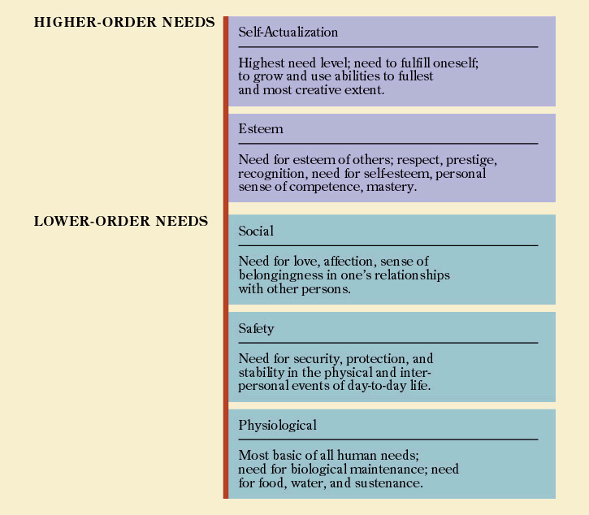

Slide 76
B. Theory X and Theory Y
Douglas McGregor proposed two distinct views of human beings: one basically negative, labeled Theory X, and the other basically positive, labeled Theory Y.
After viewing the way in which managers dealt with employees, McGregor concluded that a manager's view of the nature of human beings is based on a certain grouping of assumptions and that he or she tends to mold his or her behavior toward subordinates according to these assumptions.

Slide 77
C. Motivation-Hygiene Theory/Two-factor theory
Motivation-hygiene theory - intrinsic factors are related to job satisfaction, while extrinsic factors are associated with job dissatisfaction.
The motivation-hygiene theory was proposed by psychologist Frederick Herzberg.
He believes that an individual's relation to his or her work is a basic one and that his or her attitude toward this work can very well determine the individual's success or failure.

Slide 78
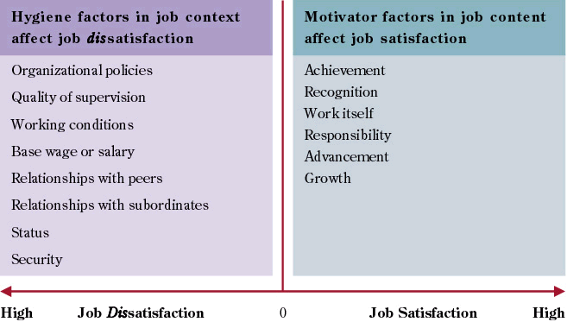

Slide 79
II. Contemporary Content theories of Motivation
A. ERG Theory
Clayton Alderfer has reworked Maslow's need hierarchy to align it more closely with the empirical research.
His revised need hierarchy is labeled ERG theory.
Alderfer argues that there are three groups of core needs-existence ( physiological and safety needs), relatedness ( social needs & external/extrinsic components of esteem needs), and growth (intrinsic components of esteem needs & self-actualization needs)-hence the label ERG theory.

Slide 80
B. Acquired needs theory
This theory is proposed by David McClelland and his associates as being important in organizational settings for understanding motivation.
McClelland's theory of needs focuses on three needs: achievement, power, and affiliation

Slide 81
2. Process Theories of Motivation
Equity theory:- According to this theory people gauge the fairness of their work outcomes in relation to others.
Individuals felt negative inequality when they feel that they have received relatively less than others in proportion to work inputs.
- Developed by J. Stacy Adams.
Individual felt positive inequality when they feel that they have received relatively more than others in proportion to work inputs.

Slide 82
B. Expectancy Theory
Currently, one of the most widely accepted explanations of motivation is Victor Vroom's expectancy theory.
Expectancy theory argues that the strength of a tendency to act in a certain way depends on the strength of an expectation that the act will be followed by a given outcome and on the attractiveness of that outcome to the individual.

Slide 83
C. Cognitive Evaluation Theory
Cognitive evaluation theory states that allocating extrinsic rewards for behavior that had been previously intrinsically rewarded tends to decrease the overall level of motivation.
The major implications for this theory relates to the way in which people are paid in organizations.

Slide 84
D. Goal-Setting Theory
Goal-setting theory states that specific, challenging/ difficult, and clear goals that lead to higher performance.
It addresses the issues of the effect of goal specificity, challenge and feedback on performance.

Slide 85
3. Reinforcement Theory
Reinforcement deals with the administration of a consequence as a result of a behavior.
Proper management of reinforcement can change the direction, level, and persistence of an individual’s behavior.
Behavior is a function of its consequences.

Slide 86
Chapter 5
Management of Organizational Conflict
Definition of Conflict
Conflict is a process that begins when one party perceives that another party has negatively affected, or is about to negatively affect, something the first party cares about.
Conflict is the process in which friction between two or more people occurs because of disagreement over goals, work methods, etc.

Slide 87
Causes of conflict in an organization
Role conflict
Work-flow interdependencies
Domain ambiguities
Power or value asymmetries
Resource scarcity

Slide 88
Types of conflict
Substantive conflict:- A fundamental disagreement over ends or goals to be pursued and the means for their accomplishment.
Emotional conflict:- Interpersonal difficulties that arise over feelings of anger, mistrust, dislike, fear, resentment, etc.
Conflict could be functional (or constructive) conflict or Dysfunctional (or destructive) conflict.

Slide 89
Functional Vs. Dysfunctional Conflict
Functional Conflict:- some conflicts support the goals of the group and improve its performance; these are functional or constructive forms of conflict.
Dysfunctional Conflict:- there are conflicts that hinder group performance and these are dysfunctional or destructive forms of conflict.

Slide 90
Conflict Process
The conflict process can be seen as comprising five stages:
I. Potential opposition or incompatibility
II. Cognition and Personalization
III. Intentions
IV. Behavior
V. Outcomes.

Slide 91
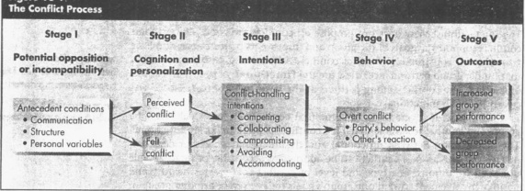
The process is diagrammed as follows:

Slide 92
Stage I: Potential Opposition or Incompatibility
Antecedent conditions for conflict or causes or sources of conflict present at this stage.
These conditions are condensed into three general categories: communication, structure, and personal variables.

Slide 93
Stage II: Cognition and Personalization
If the conditions cited in Stage I negatively affect something that one party cares about, then, the potential for opposition or incompatibility becomes actualized in the second stage.
The antecedent conditions can only lead to conflict when one or more of the parties are affected by, and aware of the conflict.
Both perceived conflict and felt conflict exist.

Slide 94
Stage III: Intentions
Intentions are decisions to act in a given way.
There are five conflict-handling intentions based on degree of cooperativeness (the degree to which one party attempts to satisfy the other party's concerns) and assertiveness (the degree to which one party attempts to satisfy his or her own concerns).

Slide 95
The following are the five conflict handling intentions:
Competing (assertive and uncooperative)
Collaborating (assertive and cooperative)
Avoiding (unassertive and uncooperative)
Accommodating (unassertive and cooperative) and
Compromising (midrange on both assertiveness and cooperativeness).

Slide 96
Competing- When one person seeks to satisfy his or her own interests, regardless of the impact on the other parties to the conflict, he or she is competing.
In collaborating, the intention of the parties is to solve the problem by clarifying differences rather than by accommodating various points of view.

Slide 97
3. Avoiding- A person may recognize that a conflict exists and want to withdraw from it or suppress it.
4. Accommodating - When one party seeks to appease an opponent, that party may be willing to place the opponent's interests above his or her own.
5. Compromising- When each party to the conflict seeks to give up something, sharing occurs, resulting in a compromised outcome.

Slide 98
Stage IV: Behavior
This is stage at which or where conflicts become visible.
The behavior stage includes the statements, actions, and reactions made by the conflicting parties.
These conflict behaviors are usually overt attempts to implement each party's intentions.

Slide 99
Stage V: Outcomes
As our model demonstrates, these outcomes may be functional, in that the conflict results in an improvement in the group's performance, or dysfunctional, in that it hinders group performance.
Conflict is constructive when it improves the quality of decisions, stimulates creativity and innovation, encourages interest and curiosity among group members, etc. These are functional outcomes.

Slide 100
Conflict is dysfunctional or destructive when it results in more undesirable consequences such as retarding of communication, reductions in group cohesiveness, and subordination of group goals to the primacy of infighting between members, etc. These are dysfunctional outcomes.

Slide 101
Conflict Management Strategies
Conflict management strategies refer to techniques or strategies used to increase or decrease conflict in organizational setting according to situations to manage it.
The following are some of the list of the major conflict resolution and stimulation techniques that allow managers to control conflict levels: Communication, bringing in outsiders, restructuring the organization, and appointing of devil’s advocate.

Slide 102
Other Conflict Resolution Techniques
The following are also important conflict resolution techniques:
- Problem solving
Expansion of resources
Avoidance
Smoothing
Compromise
Authoritative Command, etc.

Slide 103
Reading Assignment:- Indirect conflict management approaches and Direct conflict management approaches

Slide 104
Chapter 6
Stress Management
What is Stress?
Stress is a dynamic condition in which an individual is confronted with an opportunity, constraint, or demand related to what he or she desires and for which the outcome is perceived to be both uncertain and important.
Stress - An adaptive response to a situation that is perceived as challenging or threatening to the person’s well- being. Stressors- an environmental condition or stimuli that places physical or emotional demand on a person.

Slide 105
Types of stress
Episodic Stress- pattern of high stress followed by intervals of relief.
Chronic Stress- constant confrontation of stressors without relief with effects constant and Additive
Distress- stress that has a negative consequence on a person’s well-being.

Slide 106
Understanding Source of Stress and its Consequences
Potential Sources of Stress
- The three categories of potential stressors or sources of stress: 1. environmental factors 2. organizational factors and 3. individual factors
1. Environmental factors- Just as environmental uncertainty influences the design of an organization's structure, it also influences stress levels among employees in that organization. For instance, changes in the business cycle creates economic uncertainties.

Slide 107
2. Organizational factors:- Numerous factors within the organization can cause stress. Pressures to avoid errors or complete tasks in a limited time period, work overload, a demanding and insensitive boss; and unpleasant coworkers are a few examples.
3. Individual Factors :- Primarily, these factors are family issues, personal economic problems, and inherent personality characteristics. For example, marital difficulties.

Slide 108
Individual Differences and Stress
Some people thrive on stressful situations; others are overwhelmed by them.
What is it that differentiates people in terms of their ability to handle stress? What individual difference variables moderate the relationship between potential stressors and experienced stress?
At least five variables: perception, job experience, social support, belief in locus of control, and hostility have been found to be relevant moderators.

Slide 109
Consequences of Stress
The following three are consequences of stress:
1. Physiological
Psychological
Behavioral symptoms.

Slide 110
1. Physiological Symptoms
Stress could create changes in metabolism, increase heart and breathing rates, increase blood pressure, bring on headaches, and induce heart attacks, etc.
The link between stress and particular physiological symptoms is not clear because of complexity of the symptoms and the difficulty of objectively measuring them.

Slide 111
2. Psychological Symptoms
Stress can cause dissatisfaction. Job-related stress can cause job-related dissatisfaction.
Job dissatisfaction, in fact, is lithe simplest and most obvious psychological effect of stress.
But stress shows itself in other psychological states-for instance, tension, anxiety, irritability, boredom, and procrastination.

Slide 112
3. Behavioral Symptoms
- Behaviorally related stress symptoms include changes in productivity, absence, and turnover, as well as changes in eating habits, increased smoking or consumption of alcohol, rapid speech, fidgeting, and sleep disorders.

Slide 113
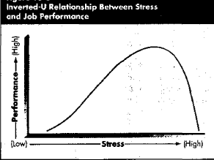
Relationship between Stress and Job Performance

Slide 114
Stress management strategies
Individual approaches- An employee can take personal responsibility for reducing his or her stress level. Individual strategies that have proven effective include implementing time-management techniques, increasing physical exercise, relaxation, training, and expanding the social support network.
Organizational approaches- Several of the factors that cause stress particularly task and role demands, and organization structure-are controlled by management.

Slide 115
Stress and Occupations
Accountant
Artist
Auto Mechanic
Forester
Hospital manager
Physician (GP)
Psychologist
School principal
Police officer
911 operator
U.S. president
Waiter/waitress
Low Stress Medium Stress High Stress
Occupations Occupations Occupations

Slide 116
Chapter 7
Culture and Diversity
Culture and Cultural Diversity
Organizational culture:- Set of key characteristics that distinguish one organization from other.
It is the collections of traditions, values, policies, beliefs, work methods, decision methods, and attitudes that constitute a pervasive context for everything we do and think in an organization.
The set of key values, beliefs, understandings, and norms that members of an organization share.

Slide 117
The following are characteristics of culture:
Culture is descriptive
Cultures may be strong or weak.
Culture is the social glue that helps hold an organization together.
Culture gives members an organizational identity
It facilitates collective commitment.
It promotes systems stability
It shapes behavior by helping members make sense of their surroundings.
It has a boundary- defining roles
It conveys a sense of identity for organizational members
It facilitates the generation of commitment
It enhances social system stability
It serves as a sense-making and control mechanisms,
Culture could be visible and invisible, etc.

Slide 118
Types of cultures or Organizational Cultures
1. A dominant culture - expresses the core values that are shared by a majority of the organization’s members (personality of the organization).
2. Core values - are those values which form the foundation on which members of an organization perform work and conduct themselves.
3. Subcultures - tend to develop in large organizations to reflect common problems, situations, or experiences that members face.

Slide 119
4. Tough guy, macho culture – a world of individuals who regularly take high risks and get quick feedback on whether their actions were right or wrong.
Work hard/pay hard culture – fun and action are the rule here, employees take few risks, all with quick feedback; to succeed, the culture, and the culture encourages them to maintain a high level of relatively low-risk activity.
High-Performance culture

Slide 120
Visible Manifestations of Culture
Symbols
Stories
Heroes
Slogans
Ceremonies, etc.

Slide 121
How a Culture Begins/is formed?
Culture is created in three ways:
  Founders hire and keep those who think and feel the same way they do.
  They indoctrinate and socialize these employees to their way of thinking and feeling
  Their behavior acts as a role model encouraging employees to identify with them

Slide 122
How employees learn culture?
Culture is transmitted to employees in a number of forms:
a. Rituals – it is repetitive sequences of activities that expresses and reinforce the key values of the organization.
b. Material symbols
c. Language - many organizations and units within organizations uses language to identify members of culture or sub-culture.

Slide 123
Cont’d …
d. National culture – there is a growing body of evidence to indicate that national culture differ widely and the result is marked differences in behavior patterns worldwide.
e. Cultural clusters- are grouping of countries into meaningful categories based on geography, shared language and similar religions.
f. Stories – many stories circulate through organizations. They serve as powerful social perceptions of the way things should (should not) be done.

Slide 124
Organizational Culture vs. National Culture
National culture has a greater impact on employees than does their organization’s culture.
Expect that organizations hire employees who are a better fit with the organization’s dominant culture even though they may not fit the national culture.

Slide 125
Culture as a Liability
Shared values do not agree with organization’s effectiveness.
Dilemma of hiring a diverse workforce but wanting people to fit into a single culture.
Cultural incompatibility in mergers and acquisitions.
Culture is not good or bad, only it exists.
Valuable for both organization and employee
It enhances organizational commitment and increases the consistency of employee behavior.

Slide 126
CHAPTER 8
POWER AND POLITICS IN AN ORGANIZATION
Power refers to a capacity that somebody has to influence the behavior of other person, so the latter does something he or she would not otherwise does.
Power is ability to influence the actions and behaviour of other person because of various reasons.

Slide 127
Bases of Power
The following are bases or sources of power:
1. Coercive Power:- the coercive power is out of fear of the negative results that might occur if one failed to comply. For example, power by physical sanctions or frustrations through force.
2. Expert Power :- Expert power is influence wielded as a result of expertise, special skill, or knowledge.

Slide 128
CONT’D…
3. Referent Power:- Its base is identification with a person who has desirable resources or personal traits. Referent power develops out of admiration of another and a desire to be like that person.
4. Legitimate Power:- power because of formal authority

Slide 129
POLITICAL IMPLICATIONS OF POWER
Power and politics are very closely related concepts.
A popular view of organizational politics is how one can pragmatically get ahead in an organization.
Power and politics become especially closely intertwined.
Study show that managers who lack power must use more politics.

Slide 130
A Political Perspective of Power in Organizations
The classical organization theorists portrayed organizations as highly rational structures in which authority meticulously followed the chain of command and in which managers had legitimatized power.
As Peffer notes: “Organizations, particularly large ones, are like governments in that they are fundamentally political entities. To understand them, one needs to understand organizational politics, just as to understand governments, one needs to understand governmental politics.”

Slide 131
CONT’D…
Researchers on organizational politics conclude that politics in organizations is simply a fact of life.
Personal experience, hunches, and anecdotal evidence for years have supported a general belief that behavior in and of organizations is often political in nature.
More recently, some conceptual and empirical research has added further support to these notions.
Even though the organizational politics has and will continue to flourish, its nature and how it is expressed changes over time.

Slide 132
Political Strategies for Attaining Power in Organizations
Promoting limited communication
Exhibiting confidence
Controlling access to information and persons
Making activities central and non substitutable
Stimulating competition among ambitious subordinates
Seek out and befriend the most influential individual in a situation
Neutralizing potential opposition
Making strategic replacements
Forming a winning coalition
Developing expertise, etc.

Slide 133
Chapter 9
Organizational Design and Structure
Organizational design refers to the overall configuration structural components that define jobs, grouping of jobs, the hierarchy, patterns of authority and approaches to coordination, and line-staff differentiation into a single, unified organizational system.
Similarly, Ivancevich and Matton defined the concept of organizational design as a managerial decision making aimed at determining the structure and purposes that coordinate and control the jobs of the organization. And, the outcome of organizational design decision is the framework or structure of the organization.

Slide 134
CONT’D…
Organizational design is the creation and modification of organizational structure.
To achieve coordinated behavior and to satisfy evaluators, managers engage in activities intended to plan, organize, lead and control behavior.
Major factors in determining individual and group behavior are task and authority relationships.

Slide 135
Principles of Designing Organizational Structure
Peter Drucker, is a well known management philosopher and scientist, advances the following principles for designing organizations structure:
Clarity
Economy
Decision-making
Stability, adaptability, etc.

Slide 136
Types of Organizational Structure
Line Organization :-
this is the oldest and simplest form of organization.
All other kinds of structures are modifications of line structure.
It is characterized by vertical relationships which connects jobs and positions at each level with those above and below it.
It thus, creates network of hierarchy throughout the organization based on a chain of command.
It has advantages & disadvantages.

Slide 137
2. Line and staff organization
Line and staff authority allows staff units to provide specialized expertise, advice, support or service to line managers in the effective performance of their functions.
They have no general command authority over line but within their own units staff specialists are related with one another in scalar chain.
The staff units contribute indirectly to accomplishing an organization’s goal. Each staff is a specialist in his/her area and operates with considerable independence.
It has advantages and disadvantages.

Slide 138
3. Functional structure
Functional authority exists when staff units exercise command authority over specific matters of line functions.
Example, if a quality control manager prescribes quality specifications, it binds the production manager and the quality control manager exercises functional authority over the latter.
It has advantages and disadvantages.

Slide 139
4. Matrix organization
This type of authority relationship is introduced in response to the growing complexity and size of technically oriented enterprises, which needed more flexibility.
It is the result of the need for specialized decision making and to achieve more balanced form of organization structure.
It organizes activities by combining functional and task force or product departmentalization to form a rigid or matrix.
It has advantages and disadvantages.

Slide 140
END !!

