Slide 1
Server side scripting | Client side scripting
Used to create dynamic pages based a number of conditions when the user’s browser makes a request to the server. | used when the user’s browser already has all the code and the page is altered on the basis of the users input.
The Web Server executes the server-side scripting that produces the page to be sent to the browser. | The Web Browser executes the client-side scripting that resides at the user’s computer.
Server executes server-side scripts to send out a page but it does not execute client-side scripts. | The browser receives the page sent by the server and executes the client-side scripts.
Used to connect to the databases that reside on the web server. | Cannot be used to connect to the databases on the web server.
can access the file system residing at the web server. | can’t access the file system that resides at the web server
The settings that belong to Web server can be accessed using server-side scripting. | The files and settings that are local at the user’s computer can be accessed using Client-side scripting.

Slide 2
Cont…
can’t be blocked by the user | possible to be blocked by the user.
Response from a server-side script is slower as compared to a client-side script | Response from a client-side script is faster as compared to a server-side script
Examples: PHP, JSP, ASP, ASP.Net, Ruby, Perl. | Examples: Javascript, VB script, etc.

Slide 3

What is PHP?
PHP was originally an acronym for Personal Home Pages.
But now it is an acronym for Hypertext Preprocessor.
It was developed as an open source.
It contains a combination of HTML and scripting.
Its file is an extension of .php
How does PHP work?

Slide 4

Cont…

Slide 5
Servers
PHP is a server-side technology. Therefore, you need to have a server to run PHP.
What is a PHP File?
PHP files can contain text, HTML, CSS, JavaScript, and PHP code
PHP code are executed on the server, and the result is returned to the browser as plain HTML
PHP files have extension ".php“
What Can PHP Do?
PHP can generate dynamic page content.
PHP can create, open, read, write, delete, and close files on the server.
PHP can collect form data.
PHP can send and receive cookies.
PHP can add, delete, modify data in your database.
PHP can restrict users to access some pages on your website.
PHP can encrypt data.

Slide 6
Why We use PHP?
PHP runs on various platforms (Windows, Linux, Unix, Mac OS X, etc.)
PHP is compatible with almost all servers used today (Apache, IIS, etc.)
PHP supports a wide range of databases.
PHP is free.
PHP is easy to learn and runs efficiently on the server side.
What Do I Need?
To start using PHP, you can:
Find a web host with PHP and MySQL support
Install a web server on your own PC, and then install PHP and MySQL.
Set Up PHP on Your Own PC
However, if your server does not support PHP, you must:
install a web server
install PHP
install a database, such as MySQL
The official PHP website (PHP.net) has installation instructions for PHP.
The PHP script is executed on the server, and the plain HTML result is sent back to the browser.

Slide 7
Basic PHP Syntax
A PHP script can be placed anywhere in the document.
<? php
// PHP code goes here
?>
A PHP script starts with <?php and ends with ?>:
The default file extension for PHP files is ".php".
A PHP file normally contains HTML tags, and some PHP scripting code.
Example
<!DOCTYPE html>
<html>
<body>
<h1>My first PHP page</h1>
<?php
echo "Hello World!";
?>
</body>
</html>

Slide 8
Comments in PHP
A comment in PHP code is a line that is not read/executed as part of the program. Its only purpose is to be read by someone who is editing the code!
Comments are useful for:
To let others understand what you are doing .
To remind yourself what you did .
PHP supports three ways of commenting:
Example
<!DOCTYPE html>
<html>
<body>
<?php
// This is a single line comment
# This is also a single line comment
/*
This is a multiple lines comment block
that spans over more than
one line
*/
?>
</body>
</html>

Slide 9
PHP Case Sensitivity
In PHP, all user-defined functions, classes, and keywords (e.g. if, else, while, echo, etc.) are NOT case-sensitive.
In the example below, all three echo statements below are legal (and equal):
Example
<!DOCTYPE html>
<html>
<body>
<?php
ECHO "Hello World!<br>";
echo "Hello World!<br>";
EcHo "Hello World!<br>";
?>
</body>
</html>
However; in PHP, all variables are case-sensitive.

Slide 10
Cont…
However; in PHP, all variables are case-sensitive.
Example
<!DOCTYPE html>
<html>
<body>
<?php
$color="red";
echo "My car is " . $color . "<br>";
echo "My house is " . $COLOR . "<br>";
echo "My boat is " . $coLOR . "<br>";
?>
</body>
</html>
PHP Variables
Variables are "containers" for storing information:

Slide 11
Cont…
Example
<?php
$x=5;
$y=6;
$z=$x+$y;
echo $z;
?>
Rules for PHP variables:
A variable starts with the $ sign, followed by the name of the variable
A variable name must start with a letter or the underscore character
A variable name cannot start with a number
A variable name can only contain alpha-numeric characters and underscores (A-z, 0-9, and _ )
Variable names are case sensitive ($y and $Y are two different variables)
NOTE: Remember that PHP variable names are case-sensitive!

Slide 12
Declaring PHP Variables
PHP has no command for declaring a variable.
A variable is created the moment you first assign a value to it:
Example
<?php
$txt="Hello world!";
$x=5;
$y=10.5;
?>
Note: When you assign a text value to a variable, put quotes around the value.
PHP is a Loosely Type Language
PHP automatically converts the variable to the correct data type, depending on its value.
PHP Variables Scope
In PHP, variables can be declared anywhere in the script.
The scope of a variable is the part of the script where the variable can be referenced/used.
PHP has three different variable scopes:

Slide 13
Cont…
local
global
static
Local and Global Scope
A variable declared outside a function has a GLOBAL SCOPE and can only be accessed outside a function.
A variable declared within a function has a LOCAL SCOPE and can only be accessed within that function.
The following example tests variables with local and global scope:
Example
<?php
$x=5; // global scope
function myTest() {
$y=10; // local scope
echo "<p>Test variables inside the function:</p>";
echo "Variable x is: $x";
echo "<br>";
echo "Variable y is: $y";
}
myTest();
echo "<p>Test variables outside the function:</p>";
echo "Variable x is: $x";
echo "<br>";
echo "Variable y is: $y";
?>

Slide 14
Cont…
Note: You can have local variables with the same name in different functions, because local variables are only recognized by the function in which they are declared.
PHP The global Keyword
The global keyword is used to access a global variable from within a function.
To do this, use the global keyword before the variables (inside the function):
Example
<?php
$x=5;
$y=10;
function myTest() {
global $x,$y;
$y=$x+$y;
}
myTest();
echo $y; // outputs 15
?>

Slide 15
PHP The static Keyword
Normally, when a function is completed/executed, all of its variables are deleted. However, sometimes we want a local variable NOT to be deleted. We need it for a further job.
To do this, use the static keyword when you first declare the variable:
Example
<?php
function myTest() {
static $x=0;
echo $x;
$x++;
}
myTest();
myTest();
myTest();
?>
Note: The variable is still local to the function.

Slide 16
PHP echo and print Statements
There are some differences between echo and print:
echo - can output one or more strings
print - can only output one string, and returns always 1
NOTE: echo is marginally faster compared to print as echo does not return any value.
The PHP echo Statement
echo is a language construct, and can be used with or without parentheses: echo or echo().
Example
<?php
echo "<h2>PHP is fun!</h2>";
echo "Hello world!<br>";
echo "I'm about to learn PHP!<br>";
echo "This", " string", " was", " made", " with multiple parameters.";
?>

Slide 17
Display Variables
The following example shows how to display strings and variables with the echo command:
Example
<?php
$txt1="Learn PHP";
$txt2="W3Schools.com";
$cars=array("Volvo","BMW","Toyota");
echo $txt1;
echo "<br>";
echo "Study PHP at $txt2";
echo "My car is a {$cars[0]}";
?>
The PHP print Statement
print is also a language construct, and can be used with or without parentheses: print or print().

Slide 18
Cont…
Example
<?php
print "<h2>PHP is fun!</h2>";
print "Hello world!<br>";
print "I'm about to learn PHP!";
?>
PHP Data Types
String, Integer, Floating point numbers, Boolean, Array, Object, NULL.
PHP Strings
A string is a sequence of characters, like "Hello world!".
A string can be any text inside quotes. You can use single or double quotes:

Slide 19
Cont…
Example
<?php
$x = "Hello world!";
echo $x;
echo "<br>";
$x = 'Hello world!';
echo $x;
?>
PHP Integers
An integer is a number without decimals.
Rules for integers:
An integer must have at least one digit (0-9)
An integer cannot contain comma or blanks
An integer must not have a decimal point
An integer can be either positive or negative
Integers can be specified in three formats: decimal (10-based), hexadecimal (16-based - prefixed with 0x) or octal (8-based - prefixed with 0)

Slide 20
Cont…
The PHP var_dump() function returns the data type and value of variables:
Example
<?php
$x = 5985;
var_dump($x);
echo "<br>";
$x = -345; // negative number
var_dump($x);
echo "<br>";
$x = 0x8C; // hexadecimal number
var_dump($x);
echo "<br>";
$x = 047; // octal number
var_dump($x);
?>

Slide 21
PHP Floating Point Numbers
A floating point number is a number with a decimal point or a number in exponential form.
Example
<?php
$x = 10.365;
var_dump($x);
echo "<br>";
$x = 2.4e3;
var_dump($x);
echo "<br>";
$x = 8E-5;
var_dump($x);
?>

Slide 22
PHP Booleans
Booleans can be either TRUE or FALSE.
$x=true;
$y=false;
Booleans are often used in conditional testing.
PHP Arrays
An array stores multiple values in one single variable.
In the following example we create an array, and then use the PHP var_dump() function to return the data type and value of the array:
Example
<?php
$cars=array("Volvo","BMW","Toyota");
var_dump($cars);
?>
PHP Objects
An object is a data type which stores data and information on how to process that data.

Slide 23
Cont…
In PHP, an object must be explicitly declared.
First we must declare a class of object. For this, we use the class keyword. A class is a structure that can contain properties and methods.
We then define the data type in the object class, and then we use the data type in instances of that class:
Example
<?php
class Car
{
var $color;
function Car($color="green") {
$this->color = $color;
}
function what_color() {
return $this->color;
}
}
?>

Slide 24
PHP NULL Value
The special NULL value represents that a variable has no value. NULL is the only possible value of data type NULL.
The NULL value identifies whether a variable is empty or not. Also useful to differentiate between the empty string and null values of databases.
Variables can be emptied by setting the value to NULL:
Example
<?php
$x="Hello world!";
$x=null;
var_dump($x);
?>
PHP String Functions
A string is a sequence of characters, like "Hello world!".
The PHP strlen() function
The strlen() function returns the length of a string, in characters.

Slide 25
Cont…
Example
<?php
echo strlen("Hello world!");
?>
The output of the code above will be: 12
Tip: strlen() is often used in loops or other functions, when it is important to know when a string ends. (i.e. in a loop, we might want to stop the loop after the last character in a string).
The PHP strpos() function
The strpos() function is used to search for a specified character or text within a string.
If a match is found, it will return the character position of the first match. If no match is found, it will return FALSE.
Example
<?php
echo strpos("Hello world!","world");
?>
The output of the code above will be: 6.

Slide 26
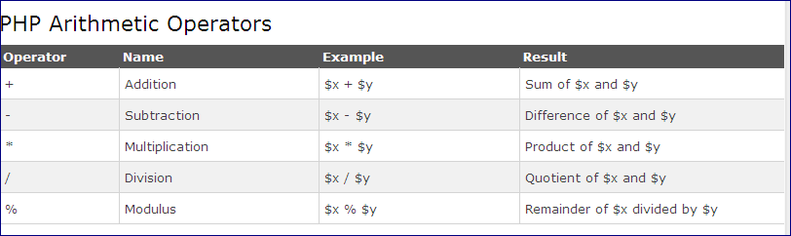
PHP Operators

Slide 27
Cont…
Example
<?php
$x=10;
$y=6;
echo ($x + $y); // outputs 16
echo ($x - $y); // outputs 4
echo ($x * $y); // outputs 60
echo ($x / $y); // outputs 1.6666666666667
echo ($x % $y); // outputs 4
?>
PHP Assignment Operators
The PHP assignment operator is used to write a value to a variable.
The basic assignment operator in PHP is "=". It means that the left operand gets set to the value of the assignment expression on the right.

Slide 28
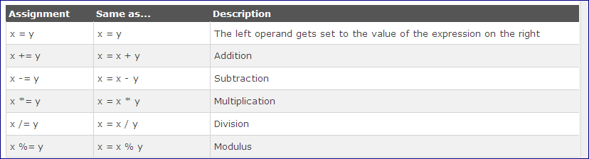
Cont…

Slide 29
Cont…
Example
<?php
$x=10;
echo $x; // outputs 10
$y=20;
$y += 100;
echo $y; // outputs 120
$z=50;
$z -= 25;
echo $z; // outputs 25
$i=5;
$i *= 6;
echo $i; // outputs 30
$j=10;
$j /= 5;
echo $j; // outputs 2
$k=15;
$k %= 4;
echo $k; // outputs 3
?>

Slide 30
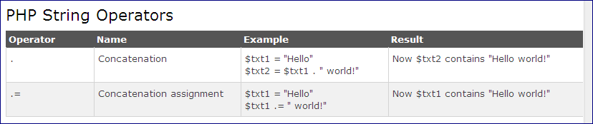
Cont…

Slide 31
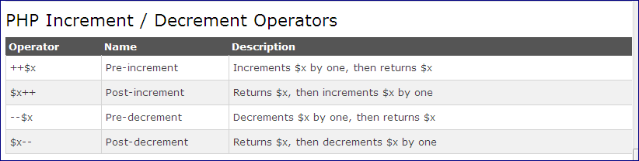
Cont…
Example
<?php
$a = "Hello";
$b = $a . " world!";
echo $b; // outputs Hello world!
$x="Hello";
$x .= " world!";
echo $x; // outputs Hello world!
?>

Slide 32
Cont…
Example
<?php
$x=10;
echo ++$x; // outputs 11
$y=10;
echo $y++; // outputs 10
$z=5;
echo --$z; // outputs 4
$i=5;
echo $i--; // outputs 5
?>

Slide 33
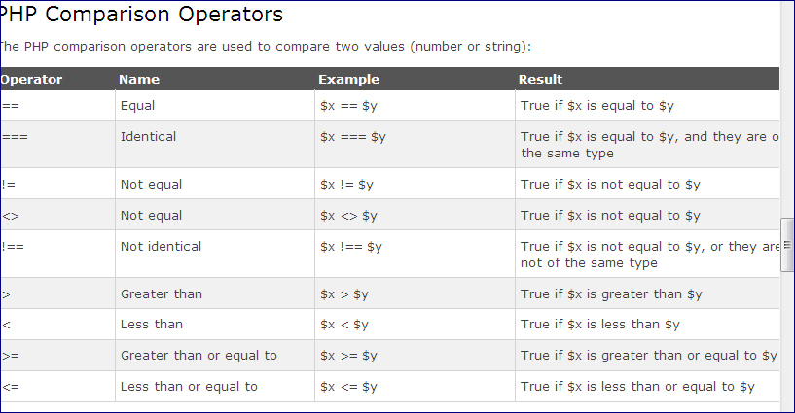
Cont…

Slide 34
Cont…
Example
<?php
$x=100;
$y="100";
var_dump($x == $y);
echo "<br>";
var_dump($x === $y);
echo "<br>";
var_dump($x != $y);
echo "<br>";
var_dump($x !== $y);
echo "<br>";
$a=50;
$b=90;
var_dump($a > $b);
echo "<br>";
var_dump($a < $b);
?>

Slide 35
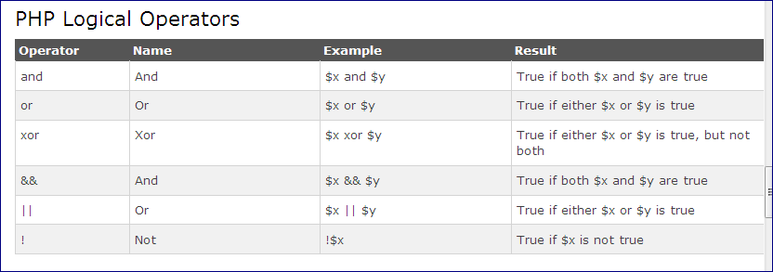
Cont..

Slide 36
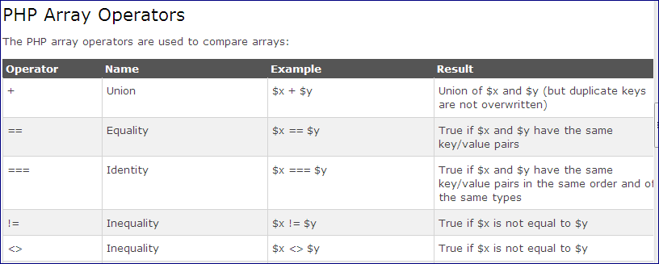
Cont..

Slide 37
Cont..
Example
<?php
$x = array("a" => "red", "b" => "green");
$y = array("c" => "blue", "d" => "yellow");
$z = $x + $y; // union of $x and $y
var_dump($z);
var_dump($x == $y);
var_dump($x === $y);
var_dump($x != $y);
var_dump($x <> $y);
var_dump($x !== $y);
?>
PHP if...else...else if Statements
Conditional statements are used to perform different actions based on different conditions.

Slide 38
PHP Conditional Statements
Very often when you write code, you want to perform different actions for different decisions. You can use conditional statements in your code to do this.
In PHP we have the following conditional statements:
if statement - executes some code only if a specified condition is true
if...else statement - executes some code if a condition is true and another code if the condition is false
if...elseif....else statement - selects one of several blocks of code to be executed
switch statement - selects one of many blocks of code to be executed
PHP - The if Statement
The if statement is used to execute some code only if a specified condition is true.
Syntax
if (condition) {
code to be executed if condition is true;
}
The example below will output "Have a good day!" if the current time (HOUR) is less than 20:

Slide 39
Cont…
Example
<?php
$t=date("H");
if ($t<"20") {
echo "Have a good day!";
}
?>
PHP switch Statement
The switch statement is used to perform different actions based on different conditions.
Use the switch statement to select one of many blocks of code to be executed.
Syntax
switch (n) {
case label1:
code to be executed if n=label1;
break;
case label2:
code to be executed if n=label2;
break;
case label3:
code to be executed if n=label3;
break;
...
default:
code to be executed if n is different from all labels;
}

Slide 40
Example
<?php
$favcolor="red";
switch ($favcolor) {
case "red":
echo "Your favorite color is red!";
break;
case "blue":
echo "Your favorite color is blue!";
break;
case "green":
echo "Your favorite color is green!";
break;
default:
echo "Your favorite color is neither red, blue, or green!";
}
?>

Slide 41
PHP while Loops
PHP while loops execute a block of code while the specified condition is true.
PHP Loops
Often when you write code, you want the same block of code to run over and over again in a row. Instead of adding several almost equal code-lines in a script, we can use loops to perform a task like this.
In PHP, we have the following looping statements:
while - loops through a block of code as long as the specified condition is true
do...while - loops through a block of code once, and then repeats the loop as long as the specified condition is true
for - loops through a block of code a specified number of times
For each- loops through a block of code for each element in an array.

Slide 42
Cont..
The while loop executes a block of code as long as the specified condition is true.
Syntax
while (condition is true) {
code to be executed;
}
The example below first sets a variable $x to 1 ($x=1;). Then, the while loop will continue to run as long as $x is less than, or equal to 5. $x will increase by 1 each time the loop runs ($x++;):
Example
<?php
$x=1;
while($x<=5) {
echo "The number is: $x <br>";
$x++;
}
?>

Slide 43
Cont…
The do...while loop will always execute the block of code once, it will then check the condition, and repeat the loop while the specified condition is true.
Syntax
do {
code to be executed;
} while (condition is true);
The example below first sets a variable $x to 1 ($x=1;). Then, the do while loop will write some output, and then increment the variable $x with 1. Then the condition is checked (is $x less than, or equal to 5?), and the loop will continue to run as long as $x is less than, or equal to 5:
Example
<?php
$x=1;
do {
echo "The number is: $x <br>";
$x++;
} while ($x<=5);
?>

Slide 44
Cont…
Notice that in a do while loop the condition is tested AFTER executing the statements within the loop. This means that the do while loop would execute its statements at least once, even if the condition fails the first time.
PHP for Loops
PHP for loops execute a block of code a specified number of times.
Syntax
for (init counter; test counter; increment counter) {
code to be executed;
}
Parameters:
init counter: Initialize the loop counter value
test counter: Evaluated for each loop iteration. If it evaluates to TRUE, the loop continues. If it evaluates to FALSE, the loop ends.
increment counter: Increases the loop counter value

Slide 45
Cont…
Example
<?php
for ($x=0; $x<=10; $x++) {
echo "The number is: $x <br>";
}
?>
The PHP for each Loop
. The for each loop works only on arrays, and is used to loop through each key/value pair in an array.
Syntax
For each ($array as $value) {
code to be executed;
}
For every loop iteration, the value of the current array element is assigned to $value and the array pointer is moved by one, until it reaches the last array element.

Slide 46
Cont…
Example
<?php
$colors = array("red","green","blue","yellow");
for each ($colors as $value) {
echo "$value <br>";
}
?>

Slide 47
PHP - Constants Types
A constant is a name or an identifier for a simple value. A constant value cannot change during the execution of the script.
By default, a constant is case-sensitive. By convention, constant identifiers are always uppercase.
A constant name starts with a letter or underscore, followed by any number of letters, numbers, or underscores.
If you have defined a constant, it can never be changed or undefined.

Slide 48
Cont…
To define a constant you have to use define() function and to retrieve the value of a constant, you have to simply specifying its name. Unlike with variables, you do not need to have a constant with a $. You can also use the function constant() to read a constant's value if you wish to obtain the constant's name dynamically.

Slide 49
Cont…
constant() function
As indicated by the name, this function will return the value of the constant.
This is useful when you want to retrieve value of a constant, but you do not know its name, i.e. It is stored in a variable or returned by a function.
Example:
<?php
define("MINSIZE", 50);
echo MINSIZE;
echo constant("MINSIZE");
?>
Only scalar data (boolean, integer, float and string) can be contained in constants.

Slide 50
Difference between constants and variables
There is no need to write a dollar sign ($) before a constant, where as in Variable one has to write a dollar sign.
Constants cannot be defined by simple assignment, they may only be defined using the define() function.
Constants may be defined and accessed anywhere without regard to variable scoping rules.
Once the Constants have been set, may not be redefined or undefined.

Slide 51
Valid and invalid constant names
// Valid constant names
define("ONE", "first thing");
define("TWO2", "second thing");
define("THREE_3", "third thing");
// Invalid constant names
define("2TWO", "second thing");
define("__THREE__", "third value");

Slide 52
PHP Functions
User defined functions
Besides the built-in PHP functions, we can create our own functions.
A function is a block of statements that can be used repeatedly in a program.
A function will not execute immediately when a page loads.
A function will be executed by a call to the function.
Create a User Defined Function in PHP
A user defined function declaration starts with the word "function":
Syntax
functionfunctionName() {
code to be executed;
}
Note: A function name can start with a letter or underscore (not a number).
Function names are NOT case-sensitive.

Slide 53
Cont…
Example
<?php
function writeMsg() {
echo "Hello world!";
}
writeMsg(); // call the function
?>
PHP Function Arguments
Information can be passed to functions through arguments. An argument is just like a variable.
Arguments are specified after the function name, inside the parentheses. You can add as many arguments as you want, just seperate them with a comma.
Example
<?php
function familyName($fname) {
echo "$fnameRefsnes.<br>";
}
familyName("Jani");
familyName("Hege");
familyName("Stale");
familyName("Kai Jim");
familyName("Borge");
?>

Slide 54
PHP Default Argument Value
The following example shows how to use a default parameter. If we call the function setHeight() without arguments it takes the default value as argument:
Example
<?php
function setHeight($minheight=50) {
echo "The height is : $minheight<br>";
}
setHeight(350);
setHeight(); // will use the default value of 50
setHeight(135);
setHeight(80);
?>
PHP Functions - Returning values
To let a function return a value, use the return statement:
Example
<?php
function sum($x,$y) {
$z=$x+$y;
return $z;
}
echo "5 + 10 = " . sum(5,10) . "<br>";
echo "7 + 13 = " . sum(7,13) . "<br>";
echo "2 + 4 = " . sum(2,4);
?>

Slide 55
PHP Arrays
An array stores multiple values in one single variable:
Example
<?php
$cars=array("Volvo","BMW","Toyota");
echo "I like " . $cars[0] . ", " . $cars[1] . " and " . $cars[2] . ".";
?>
What is an Array?
An array is a special variable, which can hold more than one value at a time.
Create an Array in PHP
In PHP, the array() function is used to create an array:
array();
In PHP, there are three types of arrays:
Indexed arrays - Arrays with numeric index
Associative arrays - Arrays with named keys
Multidimensional arrays - Arrays containing one or more arrays

Slide 56
PHP Indexed Arrays
There are two ways to create indexed arrays:
The index can be assigned automatically (index always starts at 0):
$cars=array("Volvo","BMW","Toyota");
or the index can be assigned manually:
$cars[0]="Volvo";
$cars[1]="BMW";
$cars[2]="Toyota";
Example
<?php
$cars=array("Volvo","BMW","Toyota");
echo "I like " . $cars[0] . ", " . $cars[1] . " and " . $cars[2] . ".";
?>
Get The Length of an Array - The count() Function
The count() function is used to return the length (the number of elements) of an array:
Example
<?php
$cars=array("Volvo","BMW","Toyota");
echo count($cars);
?>

Slide 57
Loop Through an Indexed Array
To loop through and print all the values of an indexed array, you could use a for loop, like this:
Example
<?php
$cars=array("Volvo","BMW","Toyota");
$arrlength=count($cars);
for($x=0;$x<$arrlength;$x++) {
echo $cars[$x];
echo "<br>";
}
?>
PHP Associative Arrays
Associative arrays are arrays that use named keys that you assign to them.
There are two ways to create an associative array:
$age=array("Peter"=>"35","Ben"=>"37","Joe"=>"43");

Slide 58
Cont…
Example
<?php
$age=array("Peter"=>"35","Ben"=>"37","Joe"=>"43");
echo "Peter is " . $age['Peter'] . " years old.";
?>
Loop Through an Associative Array
To loop through and print all the values of an associative array, you could use a foreach loop, like this:
Example
<?php
$age=array("Peter"=>"35","Ben"=>"37","Joe"=>"43");
foreach($age as $x=>$x_value) {
echo "Key=" . $x . ", Value=" . $x_value;
echo "<br>";
}
?>

Slide 59
PHP Global Variables - Superglobals
PHP $GLOBALS
$GLOBALS is a PHP super global variable which is used to access global variables from anywhere in the PHP script (also from within functions or methods).
PHP stores all global variables in an array called $GLOBALS[index]. The index holds the name of the variable.
The example below shows how to use the super global variable $GLOBALS:
Example
<?php
$x = 75;
$y = 25;
function addition() {
$GLOBALS['z'] = $GLOBALS['x'] + $GLOBALS['y'];
}
addition();
echo $z;
?>

Slide 60
PHP $_SERVER
$_SERVER is a PHP super global variable which holds information about headers, paths, and script locations.
The example below shows how to use some of the elements in $_SERVER:
Example
<?php
echo $_SERVER['PHP_SELF'];
echo "<br>";
echo $_SERVER['SERVER_NAME'];
echo "<br>";
echo $_SERVER['HTTP_HOST'];
echo "<br>";
echo $_SERVER['HTTP_REFERER'];
echo "<br>";
echo $_SERVER['HTTP_USER_AGENT'];
echo "<br>";
echo $_SERVER['SCRIPT_NAME'];
?>

Slide 61
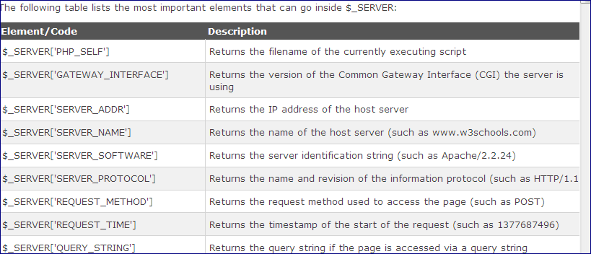
Cont…

Slide 62
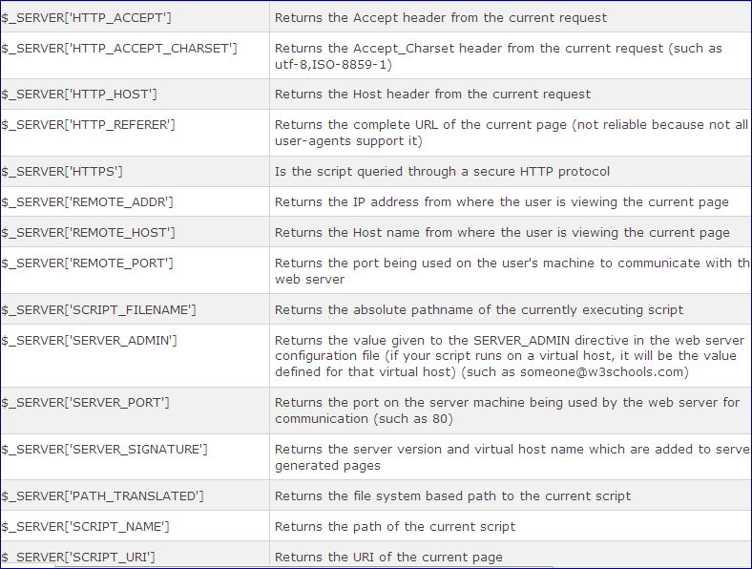
Cont…

Slide 63
PHP $_REQUEST
PHP $_REQUEST is used to collect data after submitting an HTML form.
Example
<html>
<body>
<form method="post" action="<?php echo $_SERVER['PHP_SELF'];?>">
Name: <input type="text" name="fname">
<input type="submit">
</form>
<?php
$name = $_REQUEST['fname'];
echo $name;
?>
</body>
</html>

Slide 64
PHP $_POST
PHP $_POST is widely used to collect form data after submitting an HTML form with method="post". $_POST is also widely used to pass variables.
Example
<html>
<body>
<form method="post" action="<?php echo $_SERVER['PHP_SELF'];?>">
Name: <input type="text" name="fname">
<input type="submit">
</form>
<?php
$name = $_POST['fname'];
echo $name;
?>
</body>
</html>

Slide 65
PHP $_GET
PHP $_GET can also be used to collect form data after submitting an HTML form with method="get".
$_GET can also collect data sent in the URL.
Assume we have an HTML page that contains a hyperlink with parameters:
<html>
<body>
<a href="test_get.php?subject=PHP&web=W3schools.com">Test $GET</a>
</body>
</html>
Example
<html>
<body>
<?php
echo "Study " . $_GET['subject'] . " at " . $_GET['web'];
?>
</body>
</html>

Slide 66
PHP - File Inclusion
You can include the content of a PHP file into another PHP file before the server executes it. There are two PHP functions which can be used to included one PHP file into another PHP file.
        The include() Function
        The require() Function
This is a strong point of PHP which helps in creating functions, headers, footers, or elements that can be reused on multiple pages. This will help developers to make it easy to change the layout of complete website with minimal effort. If there is any change required then instead of changing thousand of files just change included file.

Slide 67
The include() Function
The include() function takes all the text in a specified file and copies it into the file that uses the include function.
If there is any problem in loading a file then the include() function generates a warning but the script will continue execution.
Assume you want to create a common menu for your website. Then create a file menu.php with the following content.

Slide 68
Cont…
<a href="http://www.tutorialspoint.com">Home</a>
<a href="http://www.w3schools.com">w3schools</a>
<a href="http://www.ajax.com">AJAX</a>
<a href="http://www.mysql.com">MySQL</a> <br />
Now create as many pages as you like and include this file to create header. For example now your test.php file can have following content.
<html>
<body>
<?php
include("menu.php");
?>
<p>This is an example to show how to include PHP file!</p>
</body>
</html>

Slide 69
The require() Function
The require() function takes all the text in a specified file and copies it into the file that uses the include function. If there is any problem in loading a file then the require() function generates a fatal error and halt the execution of the script.
So there is no difference in require() and include() except they handle error conditions.
It is recommended to use the require() function instead of include(), because scripts should not continue executing if files are missing or misnamed.
You can try using above example with require() function and it will generate same result. But if you will try following two examples where file does not exist then you will get different results.

Slide 70
Cont…
<html>
<body>
<?php
include("xxmenu.php");
?>
<p>This is an example to show how to include wrong PHP file!</p>
</body>
</html>
output This is an example to show how to include wrong PHP file!

Slide 71
Cont…
<html>
<body>
<?php
require("xxmenu.php");
?>
<p>This is an example to show how to include wrong PHP file!</p>
</body>
</html>
output
This time file execution halts and nothing is displayed.
NOTE − You may get plain warning messages or fatal error messages or nothing at all. This depends on your PHP Server configuration.

Slide 72
Creating Directories in PHP
A new directory can be created in PHP using the mkdir() function.
This function takes a path to the directory to be created.
To create a directory in the same directory as your PHP script simply provide the directory name.
To create a new directory in a different directory specify the full path when calling mkdir().

Slide 73
Cont…
<?php
$result = mkdir ("/path/to/directory", "0777");
?>
Deleting a Directory
Directories are deleted in PHP using the rmdir() function.
rmdir() takes a single argument, the name of the directory to be deleted.
The deletion will only be successful if the directory is empty.
If the directory contains files or other sub-directories the deletion cannot be performed until those files and sub-directories are also deleted.

Slide 74
Read files in PHP
The fread() function reads from an open file.
The first parameter of fread() contains the name of the file to read from and the second parameter specifies the maximum number of bytes to read.
Example:-
<?php
$myFile = "sampleFile2.txt";
$fh = fopen($myFile, 'r');
$myFileContents = fread($fh,filesize("samplefile2.txt"));
fclose($fh);
echo $myFileContents;
?>

Slide 75
Write to File in PHP
The fwrite() function is used to write to a file.
The first parameter of fwrite() contains the name of the file to write to and the second parameter is the string to be written.
Example:
<?php
$myFile2 = "sampleFile2.txt";
$myFileLink2 = fopen($myFile2, 'a') or die("Can't open file.");
$newContents = "I am a student";
fwrite($myFileLink2, $newContents);
fclose($myFileLink2);
?>

Slide 76
Open File in PHP
A better method to open files is with the fopen() function.
The first parameter of fopen() contains the name of the file to be opened and the second parameter specifies in which mode the file should be opened.

Slide 77
Cont…
Modes | Description
r | Open a file for read only. File pointer starts at the beginning of the file
w | Open a file for write only. Erases the contents of the file or creates a new file if it doesn't exist. File pointer starts at the beginning of the file
a | Open a file for write only. The existing data in file is preserved. File pointer starts at the end of the file. Creates a new file if the file doesn't exist
x | Creates a new file for write only. Returns FALSE and an error if file already exists
r+ | Open a file for read/write. File pointer starts at the beginning of the file
w+ | Open a file for read/write. Erases the contents of the file or creates a new file if it doesn't exist. File pointer starts at the beginning of the file
a+ | Open a file for read/write. The existing data in file is preserved. File pointer starts at the end of the file. Creates a new file if the file doesn't exist
x+ | Creates a new file for read/write. Returns FALSE and an error if file already exists

Slide 78
PHP Cookies
A cookie is often used to identify a user.
What is a Cookie?
A cookie is often used to identify a user. A cookie is a small file that the server embeds on the user's computer. Each time the same computer requests a page with a browser, it will send the cookie too. With PHP, you can both create and retrieve cookie values.
Create Cookies With PHP
A cookie is created with the setcookie() function.
Syntax
setcookie(name, value, expire, path, domain, secure, httponly);
Only the name parameter is required. All other parameters are optional.
PHP Create/Retrieve a Cookie
The following example creates a cookie named "user" with the value "John Doe". The cookie will expire after 30 days (86400 * 30). The "/" means that the cookie is available in entire website (otherwise, select the directory you prefer).
We then retrieve the value of the cookie "user" (using the global variable $_COOKIE). We also use the isset() function to find out if the cookie is set:
Note: The setcookie() function must appear BEFORE the <html> tag.

Slide 79
Cont…
Example
<?php
$cookie_name = "user";
$cookie_value = "John Doe";
setcookie($cookie_name, $cookie_value, time() + (86400 * 30), "/"); // 86400 = 1 day
?>
<html>
<body>
<?php
if(!isset($_COOKIE[$cookie_name])) {
echo "Cookie named '" . $cookie_name . "' is not set!";
} else {
echo "Cookie '" . $cookie_name . "' is set!<br>";
echo "Value is: " . $_COOKIE[$cookie_name];
}
?>
</body>
</html>

Slide 80
PHP Sessions
A session is a way to store information (in variables) to be used across multiple pages.
Unlike a cookie, the information is not stored on the users computer.
Session variables hold information about one single user, and are available to all pages in one application.
If you need a permanent storage, you may want to store the data in a database.
A session is started with the session_start() function.
Session variables are set with the PHP global variable: $_SESSION.
Example
<?php
// Start the session
session_start();
?>
<!DOCTYPE html>
<html>
<body>
<?php
// Set session variables
$_SESSION["favcolor"] = "green";
$_SESSION["favanimal"] = "cat";
echo "Session variables are set.";
?>
</body>
</html>

Slide 81
Cont…
Note: The session_start() function must be the very first thing in your document. Before any HTML tags.
Get PHP Session Variable Values
Example
<?php
session_start();
?>
<!DOCTYPE html>
<html>
<body>
<?php
// Echo session variables that were set on previous page
echo "Favorite color is " . $_SESSION["favcolor"] . ".<br>";
echo "Favorite animal is " . $_SESSION["favanimal"] . ".";
?>
</body>
</html>
Destroy a PHP Session
To remove all global session variables and destroy the session, use session_unset() and session_destroy():

Slide 82
Cont…
Example
<?php
session_start();
?>
<!DOCTYPE html>
<html>
<body>
<?php
// remove all session variables
session_unset();
// destroy the session
session_destroy();
?>
</body>
</html>

Slide 83
PHP MySQL Database
With PHP, you can connect to and manipulate databases.
MySQL is the most popular database system used with PHP.
What is MySQL?
MySQL is a database system used on the web
MySQL is a database system that runs on a server
MySQL is ideal for both small and large applications
MySQL is very fast, reliable, and easy to use
MySQL uses standard SQL
MySQL compiles on a number of platforms
MySQL is free to download and use
MySQL is developed, distributed, and supported by Oracle Corporation
The data in a MySQL database are stored in tables. A table is a collection of related data, and it consists of columns and rows.
Database Queries
A query is a question or a request.
We can query a database for specific information and have a recordset returned.
Example:
SELECT LastName FROM Employees

Slide 84
Connecting to databases
To connect PHP with database, four important things must be taken place. Those are:-
      Define constants
      Create connection using mysql_connect.
      Select database.
      Close connection.

Slide 85
1. Define constants
To connect php with database, defining constants is very important. Constants that must be defined are:-
        Define the server.
        Define user name of the server.
        Define password of the user.
        Define database name.
To define the constant, we can use as follows:
        <?php
        define("db_server","localhost");// the server that we use
        define("db_user","root");// the username of the server
        define("db_pass","");//password of the server
        define("db_name","schoolmgt");//the database that we use
        ?>

Slide 86
2. Opening Database Connection
After defining constants using php, opening or creating connection is very important. To open or create database connection, we use mysql_connect function.
This function takes three parameters. Those are:
db_server,db_user,db_pass.
The password of the user accessing the database.
The host name running database server The username accessing the database
From the above the host name running database server is “localhost”, the username accessing the database is “user”, and the password of the user accessing the database is empty. Connection can opened or created as follows:
$connection=mysql_connect(db_server,db_user,db_pass);

Slide 87
3. Select database
Once you establish a connection with a database server then it is required to select a particular database where your all the tables are associated.
This is required because there may be multiple databases residing on a single server and you can do work with a single database at a time.
To select database, we use mysql_select_db as follows:-
$db_select=mysql_select_db(db_name,$connection);
4. Closing database connection
Its simplest function mysql_close PHP provides to close a database connection. This function takes connection resource returned by mysql_connect function. For example, to close the connection that you use in the above; you use mysql_close function as follows:-
mysql_close($connection);

Slide 88
Create MySQL Database Using PHP
To create and delete a database you should have admin privilege. Its very easy to create a new MySQL database. PHP uses mysql_query function to create a MySQL database. For example to create the database test_db using php, you can write as follows:-
        <?php
        define("db_server","localhost");
        define("db_user","root");
        define("db_pass","");
        $connection=mysql_connect(db_server,db_user,db_pass);
        if(!$connection)
        {
        die("error connection to db server".mysql_error());
        }
        echo “Connected successfully”;
        $sql = “CREATE Database test_db”;
        $retval = mysql_query( $sql, $connection);
        if(! $retval ) {
        die('Could not create database: ' . mysql_error());
        }
        echo "Database test_db created successfully\n";
        mysql_close $connection);
        ?>

Slide 89
Creating Database Tables
To create tables in the new database you need to do the same thing as creating the database. First create the SQL query to create the tables then execute the query using mysql_query() function.

Slide 90
Cont…
      <?php
      define("db_server","localhost");
      define("db_user","root");
      define("db_pass","");
      define("db_name","test_db");
      $con=mysql_connect(db_server,db_user,db_pass);
      if(!$con){
      die("not connected".mysql_query());
      }
      $sqldb=mysql_select_db(db_name,$con);
      if (!$sqldb){
      die("incorrectly selected".mysql_error());
      }
      $sql = 'CREATE TABLE employee( '.
      'emp_id INT NOT NULL AUTO_INCREMENT, '.
      'emp_name VARCHAR(20) NOT NULL, '.
      'emp_address VARCHAR(20) NOT NULL, '.
      'emp_salary INT NOT NULL, '.
      'join_date timestamp(14) NOT NULL, '.
      'primary key ( emp_id ))';
      $retval = mysql_query($sql,$con);
      if(!$retval ) {
      die('Could not create table: ' . mysql_error());
      }
      echo "Table employee created successfully\n";
      ?>

Slide 91
Cont…
In case you need to create many tables then its better to create a text file first and put all the SQL commands in that text file and then load that file into $sql variable and execute those commands. Consider the following content in sql_query.txt file.
        CREATE TABLE employee
        (emp_id INT NOT NULL AUTO_INCREMENT,
        emp_name VARCHAR(20) NOT NULL,
        emp_address VARCHAR(20) NOT NULL,
        emp_salary INT NOT NULL,
        join_date timestamp(14) NOT NULL,
        primary key ( emp_id ));

Slide 92
Cont…
          <?php
          define("db_server","localhost");
          define("db_user","root");
          define("db_pass","");
          define("db_name","test_db");
          $con=mysql_connect(db_server,db_user,db_pass);
          if(!$con){
          die("not connected".mysql_query());
          }
          $sqldb=mysql_select_db(db_name,$con);
          if (!$sqldb){
          die("incorrectly selected".mysql_error());
          }
          $query_file = 'sql_query.txt';
          $fp = fopen($query_file, 'r');
          $sql = fread($fp, filesize($query_file));
          fclose($fp);
          $retval = mysql_query($sql,$con);
          if(!$retval ) {
          die('Could not create table: '.mysql_error());
          }
          echo "Table employee created successfully\n";
          ?>

Slide 93
Insert Data into MySQL Database
Data can be entered into MySQL tables by executing SQL INSERT statement through PHP function mysql_query. Below a simple example to insert a record into employee table.
sql = 'INSERT INTO employee '.
'(emp_name,emp_address, emp_salary, join_date) '.
'VALUES ( "guest", "XYZ", 2000, NOW() )';

Slide 94
Getting Data From MySQL Database
Data can be fetched from MySQL tables by executing SQL SELECT statement through PHP function mysql_query. You have several options to fetch data from MySQL.
The most frequently used option is to use function mysql_fetch_array(). This function returns row as an associative array, a numeric array, or both. This function returns FALSE if there are no more rows.
next is a simple example to fetch records from employee table.

Slide 95
Cont…
$sql = 'SELECT emp_id, emp_name, emp_salary FROM employee';
$retval = mysql_query($sql,$con);
if(!$retval ) {
die('Could not create table: ' . mysql_error());
}
while($row = mysql_fetch_array($retval, MYSQL_ASSOC)) {
echo "EMP ID :{$row['emp_id']} <br> ".
"EMP NAME : {$row['emp_name']} <br> ".
"EMP SALARY : {$row['emp_salary']} <br> ".
"--------------------------------<br>";
}

Slide 96
Cont…
The content of the rows are assigned to the variable $row and the values in row are then printed.
Always remember to put curly brackets when you want to insert an array value directly into a string.
In above example the constant MYSQL_ASSOC is used as the second argument to mysql_fetch_array(), so that it returns the row as an associative array. With an associative array you can access the field by using their name instead of using the index.
PHP provides another function called mysql_fetch_assoc() which also returns the row as an associative array.

Slide 97
Using mysql_fetch_assoc()
while($row = mysql_fetch_assoc($retval)) {
echo "EMP ID :{$row['emp_id']} <br> ".
"EMP NAME : {$row['emp_name']} <br> ".
"EMP SALARY : {$row['emp_salary']} <br> ".
"--------------------------------<br>";
}
Using MYSQL_NUM
while($row = mysql_fetch_array($retval, MYSQL_NUM)) {
echo "EMP ID :{$row[0]} <br> ".
"EMP NAME : {$row[1]} <br> ".
"EMP SALARY : {$row[2]} <br> ".
"--------------------------------<br>";
}

Slide 98
Deleting Data from MySQL Database
Data can be deleted from MySQL tables by executing SQL DELETE statement through PHP function mysql_query.
Below is a simple example to delete records into employee table. To delete a record in any table it is required to locate that record by using a conditional clause. Below example uses primary key to match a record in employee table.
$emp_id = $_POST['emp_id'];
$sql = "DELETE FROM employee WHERE emp_id= $emp_id" ;

Slide 99
Deleting MySQL Database and table Using PHP
If a database is no longer required then it can be deleted forever. You can use pass an SQL command to mysql_query to delete a database.
$sql = 'DROP DATABASE test_db’;
deleting MySQL database
$sql = 'DROP TABLE employee’;
deleting table

Slide 100
Updating Data into MySQL Database
Data can be updated into MySQL tables by executing SQL UPDATE statement through PHP function mysql_query.
Below is a simple example to update records into employee table. To update a record in any table it is required to locate that record by using a conditional clause. Below example uses primary key to match a record in employee table.
      $emp_id=$_POST['emp_id’];
      $emp_salary = $_POST['emp_salary’];
      $sql = "UPDATE employee ". "SET emp_salary = $emp_salary ". "WHERE emp_id = $emp_id" ;

