Slide 1
Lab Examples

Slide 2
How to install
The official PHP website (PHP.net) has installation instructions for PHP: http://php.net/manual/en/install.php
Follow instruction from installation material and install your xampp.
You have to install editor like Notepad++ or sublime text or any else

Slide 3
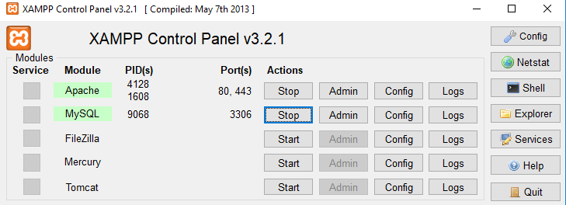
Cont’d…
Go to C:\xampp→xampp-control.exe
Click start on Apache and MySQL

Slide 4
Where to save php file?
C:/xampp/htdocs/folder/file_name.php
optional extension
Then open browsers like chrome, opera, Firefox and etc.
How to run
First you have to start xampp control (C:/xampp/xampp control.exe)
Type localhost/folder_name/file_name.php

Slide 5
variable
<?php
$txt="stay at home";//assigning string variable
$dis=2;//assigning integer variable
$tem=37.2;//assigning decimal/float variable
?>

Slide 6
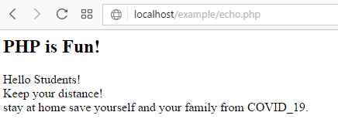
Echo and print
<?php
echo "<h2>PHP is Fun!</h2>";
echo "Hello Students!<br>";
echo "Keep your distance!<br>";
echo "stay ", "at ", "home ", "save ", "yourself ", "and your family from COVID_19.";//multiple parameters
?>

Slide 7
Cont’d…
<?php
print "<h2>PHP is Fun!</h2>";
print "Hello Students!<br>";
print "Keep your distance!<br>";
//this make error when you use print instead of echo
print "stay ", "at ", "home ", "save ", "yourself ", "and your family from COVID_19.";//multiple parameters
?>

Slide 8

Data types
<?php
$txt="stay at home";//assigning string variable
$dis=2;//assigning integer variable
$tem=37.2;//assigning decimal/float variable
/*PHP is loosely typed language means php automatically converts the variable
to the correct data type, depending on its value. */
var_dump($txt);//php function that returns data type and its value.
var_dump($dis);
var_dump($tem);
?> length of a string

Slide 9
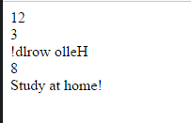
String function
<?php
//function used to know string length
echo strlen("hello world!")."<br>";//outputs 12
//function to Count the number of words in a string
echo str_word_count("Stay at home!")."<br>"; //outputs 3
//function to reverses a strings.
echo strrev("Hello world!")."<br>";
//function to specicfy its position
echo strpos("Stay at home!", "home")."<br>";
//function to replace words with another words
echo str_replace("school", "home", "Study at school!");
?>

Slide 10

If…else
<?php
$x= 4;
if($x < 12){
echo "Have a good day!";
}
else{
echo "Have a good night!";
}
?>

Slide 11
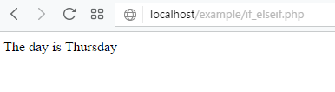
If…elseif
<?php
$x= 4;
if($x ==1){
echo "The day is Monday!";
}
elseif($x == 2){
echo "The day is Tuesday!";
}
elseif ($x == 3) {
echo "The day is Wednesday!";
}
elseif ($x == 4) {
echo "The day is Thursday";
}
elseif ($x == 5) {
echo "The day is Friday";
}
elseif ($x == 6) {
echo "The day is Saturday";
}
else{
echo "The day is Sunday";
}
?>

Slide 12
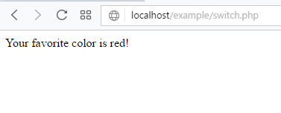
switch
<?php
$favcolor = "red";
switch ($favcolor) {
case "red":
echo "Your favorite color is red!";
break;
case "blue":
echo "Your favorite color is blue!";
break;
case "green":
echo "Your favorite color is green!";
break;
default:
echo "Your favorite color is neither red, blue, nor green!";
}
?>

Slide 13

While loop
<?php
$x=1;
while ($x <= 5) {//execution is terminated if the condition is false.
echo "$x ";
$x++;
}
?>

Slide 14

Do while loop
<?php
$x=6;
do{
echo "$x ";//here action is done before condition
$x++;
}while ( $x <= 5);//there is atleast one output even if the condition is false.
?>

Slide 15
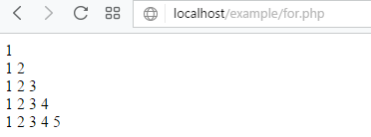
For loop
<?php
$x=2;
for($i=1;$i<=5;$i++){
for($j=1;$j<=$i;$j++){
echo "$j ";
}
echo "<br>";
}
?>

Slide 16
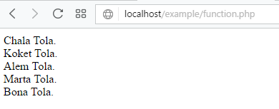
function
<?php
function familyName($fname) {
echo "$fname Tola.<br>";
}
familyName("Chala");
familyName("Koket");
familyName("Alem");
familyName("Marta");
familyName("Bona");
?>

Slide 17
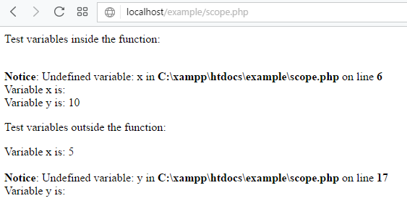
Scope
<?php
$x=5; // global scope
function myTest() {
$y=10; // local scope
echo "<p>Test variables inside the function:</p>";
echo "Variable x is: $x";
echo "<br>";
echo "Variable y is: $y";
}
myTest();
echo "<p>Test variables outside the function:</p>";
echo "Variable x is: $x";
echo "<br>";
echo "Variable y is: $y";
?>

Slide 18

Global scope
<?php
$x=5;
$y=10;
function myTest() {
global $x,$y;
$y=$x+$y;
}
myTest();
echo $y; // outputs 15
?>

Slide 19
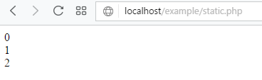
static
<?php
function myTest() {
static $x=0;
echo $x;
$x++;
}
myTest();
myTest();
myTest();
?>

Slide 20
array
<?php
$cars = array("Volvo", "BMW", "Toyota");
echo "I like " . $cars[0] . ", " . $cars[1] . " and " . $cars[2] . ".";
?>

Slide 21
Cont’d…
<html>
<body>
<?php
/* First method to associate create array. */
$salaries = array(
"Barasa" => 2000,
"Kadir" => 1000,
"Alem" => 500
);
echo "Salary of Barasa is ". $salaries['Barasa'] . "<br />";
echo "Salary of Kadir is ". $salaries['Kadir']. "<br />";
echo "Salary of Alem is ". $salaries['Alem']. "<br />";
/* Second method to create array. */
$salaries['Barasa'] = "high";
$salaries['Kadir'] = "medium";
$salaries['Alem'] = "low";
echo "Salary of Barasa is ". $salaries['Barasa'] . "<br />";
echo "Salary of Kadir is ". $salaries['Kadir']. "<br />";
echo "Salary of Alem is ". $salaries['Alem']. "<br />";
?>
</body>
</html>

Slide 22
Indexed array
<?php
$dept=array("IS","CS","IT","MIS","BAIS");
$arrlength=count($dept);
for($x=0;$x<$arrlength;$x++) {
echo $dept[$x];
echo "<br>";
}
?>

Slide 23
Associative array
<?php
$age=array("Peter"=>"35","Ben"=>"37","Joe"=>"43");
foreach($age as $x=>$x_value) {
echo "Key=" . $x . ", Value=" . $x_value;
echo "<br>";
}
?>

Slide 24
Foreach and array
<?php
$colors = array("red","green","blue","yellow");
foreach ($colors as $value) {
echo "$value <br>";
}
?>

Slide 25
Default argument
<?php
function setNumber($minnumber=5)
{
echo "The height is : $minnumber<br>";
}
setNumber(7);
setNumber(); // will use the default value of 50
setNumber(8);
setNumber(11);
?>

Slide 26
Returning argument
<?php
function sum($x,$y) {
$z=$x+$y;
return $z;
}
echo"5 + 10 = " . sum(5,10) . "<br>";
echo "7 + 13 = " . sum(7,13) . "<br>";
echo "2 + 4 = " . sum(2,4);
?>

Slide 27
Post method
<html>
<body>
<form method="post" action="<?php echo $_SERVER['PHP_SELF'];?>">
Name: <input type="text" name="fname">
<input type="submit">
</form>
<?php
$name = $_POST['fname'];
echo $name;
?>
</body>
</html>

Slide 28

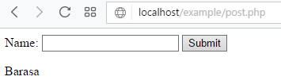
Request method
<html>
<body>
<form method="post" action="<?php echo $_SERVER['PHP_SELF'];?>">
Name: <input type="text" name="fname">
<input type="submit">
</form>
<?php
$name = $_REQUEST['fname'];
echo $name;
?>
</body>
</html>

Slide 29
Form validation
<!DOCTYPE HTML>
<html>
<head>
<style>
.error {color: #FF0000;}
</style>
</head>
<body>
<?php
// define variables and set to empty values
$nameErr = $emailErr = $genderErr = $websiteErr = "";
$name = $email = $gender = $comment = $website = "";
if ($_SERVER["REQUEST_METHOD"] == "POST")
{
if (empty($_POST["name"]))
{$nameErr = "Name is required";}
else
{
$name = test_input($_POST["name"]);
// check if name only contains letters and whitespace
if (!preg_match("/^[a-zA-Z ]*$/",$name))
{
$nameErr = "Only letters and white space allowed";
}
}

Slide 30
Cont’d…
if (empty($_POST["email"]))
{$emailErr = "Email is required";}
else
{
$email = test_input($_POST["email"]);
// check if e-mail address syntax is valid
if (!preg_match("/([\w\-]+\@[\w\-]+\.[\w\-]+)/",$email))
{
$emailErr = "Invalid email format";
}
} if (empty($_POST["website"]))
{$website = "";}
else
{
$website = test_input($_POST["website"]);

Slide 31
Cont’d…
// check if URL address syntax is valid (this regular expression also allows dashes in the URL)
if (!preg_match("/\b(?:(?:https?|ftp):\/\/|www\.)[-a-z0-9+&@#\/%?=~_|!:,.;]*[-a-z0-9+&@#\/%=~_|]/i",$website))
{
$websiteErr = "Invalid URL";
}
}
if (empty($_POST["comment"]))
{$comment = "";}
else
{$comment = test_input($_POST["comment"]);}
if (empty($_POST["gender"]))
{$genderErr = "Gender is required";}
else
{$gender = test_input($_POST["gender"]);}
}
function test_input($data)
{
$data = trim($data);
$data = stripslashes($data);
$data = htmlspecialchars($data);
return $data;
}
?>

Slide 32
Cont’d…
<h2>PHP Form Validation Example</h2>
<p><span class="error">* required field.</span></p>
<form method="post" action="<?php echo htmlspecialchars($_SERVER["PHP_SELF"]);?>">
Name: <input type="text" name="name" value="<?php echo $name;?>">
<span class="error">* <?php echo $nameErr;?></span>
<br><br>
E-mail: <input type="text" name="email" value="<?php echo $email;?>">
<span class="error">* <?php echo $emailErr;?></span>
<br><br>
Website: <input type="text" name="website" value="<?php echo $website;?>">
<span class="error"><?php echo $websiteErr;?></span>
<br><br>
Comment: <textarea name="comment" rows="5" cols="40"><?php echo
$comment;?></textarea>
<br><br>

Slide 33
Cont’d…
Gender:
<input type="radio" name="gender" <?php if (isset($gender) && $gender=="female") echo
"checked";?> value="female">Female
<input type="radio" name="gender" <?php if (isset($gender) && $gender=="male") echo
"checked";?> value="male">Male
<span class="error">* <?php echo $genderErr;?></span>
<br><br>
<input type="submit" name="submit" value="Submit">
</form>

Slide 34
Cont’d…
<?php
echo "<h2>Your Input:</h2>";
echo $name;
echo "<br>";
echo $email;
echo "<br>";
echo $website;
echo "<br>";
echo $comment;
echo "<br>";
echo $gender;
?></body></html>

Slide 35
Working with file…create
<?php // testfile.php
$fh = fopen("testfile.txt", 'w') or die("Failed to create file");
$text = <<<_END
Line 1
Line 2
Line 3
_END;
fwrite($fh, $text) or die("Could not write to file");
fclose($fh);
echo "File 'testfile.txt' written successfully";
?>

Slide 36
Read file
<?php
$fh = fopen("testfile.txt", 'r') or
die("File does not exist or you lack permission to open it");
$line = fgets($fh);
fclose($fh);
echo $line;
?>

Slide 37
Cont’d…
<?php
echo "<pre>"; // Enables display of line feeds
echo file_get_contents("testfile.txt");
echo "</pre>"; // Terminates pre tag
?>

Slide 38
Copy file
<?php // copyfile.php
copy('testfile.txt', 'testfile2.txt') or die("Could not copy file");
echo "File successfully copied to 'testfile2.txt'";
?>

Slide 39
Rename file
<?php // movefile.php
if (!rename('testfile2.txt', 'testfile2.new'))
echo "Could not rename file";
else echo "File successfully renamed to 'testfile2.new'";
?>

Slide 40
Delete file
<?php // deletefile.php
if (!unlink('testfile2.new')) echo "Could not delete file";
else echo "File 'testfile2.new' successfully deleted";
?>

Slide 41
update
<?php // update.php
$fh = fopen("testfile.txt", 'r+') or die("Failed to open file");
$text = fgets($fh);
fseek($fh, 0, SEEK_END);
fwrite($fh, "$text") or die("Could not write to file");
fclose($fh);
echo "File 'testfile.txt' successfully updated";
?>

Slide 42
Lock file
<?php
$fh = fopen("testfile.txt", 'r+') or die("Failed to open file");
$text = fgets($fh);
if (flock($fh, LOCK_EX))
{
fseek($fh, 0, SEEK_END);
fwrite($fh, "$text") or die("Could not write to file");
flock($fh, LOCK_UN);
}
fclose($fh);
echo "File 'testfile.txt' successfully updated";
?>

Slide 43
Database
Read database lab content from your handout

