Slide 1
Chapter 7
Dynamic Host Configuration Protocol (DHCP)
A Network & System Administration Perspective

Slide 2
Introduction
DHCP is s a network service that enables host computers to be automatically assigned settings from a server.
  Computers configured to be DHCP clients have no control over the settings they receive from the DHCP server.
  The configuration is transparent to the computer's user.
The most common settings provided by a DHCP server to DHCP clients include:
  IP address and Subnet Mask
  IP address of the default-gateway to use
  IP addresses of the DNS servers to use

Slide 3
Introduction…
However, a DHCP server can also supply configuration properties such as:
  Host Name: Eg. www, mail, …
  Domain Name: Eg. ambou.edu.et, aau.edu.et
  Time Server: ntp
  Print Server
Advantages of using DHCP includes:
  Changes to the network need only be changed at the DHCP server.
  It is also easier to integrate new computers into the network.
  Conflicts in IP address allocation are also reduced.

Slide 4
How DHCP works?
Manual allocation (MAC address)
  Using DHCP to identify the unique hardware address of each network card connected to the network.
  Continually supplying a constant configuration each time the DHCP client makes a request to the DHCP server using that network device.
  This ensures that a particular address is assigned automatically to that network card, based on it's MAC address.
Dynamic allocation (address pool)
  The DHCP server will assign an IP address from a pool of addresses (sometimes also called a range or scope) for a period of time or lease.
  This way, the clients will be receiving their configuration properties dynamically and on a "first come, first served“ basis

Slide 5
How DHCP works….
  When a DHCP client is no longer on the network for a specified period, the configuration is expired and released back to the address pool for use by other DHCP Clients.
Automatic allocation
  The DHCP automatically assigns an IP address permanently to a device, selecting it from a pool of available addresses.
  DHCP is used to assign a temporary address to a client, but a DHCP server can allow an infinite lease time.

Slide 6
DHCP Server Configuration
DHCP Server configuration on ‘ubuntu’ follows the following steps:
  Installation of the dhcp service (dhcpd)
    sudo apt-get install isc-dhcp-server
    Note: Edit the /etc/dhcp/dhcp.conf file to change the default confituration.
  Configuration
    Most commonly, what you want to do is assign an IP address randomly. This can be done with settings as follows:
      # minimal sample /etc/dhcp/dhcpd.conf
      default-lease-time 600;
      max-lease-time 7200;
      subnet 192.168.1.0 netmask 255.255.255.0 {
      range 192.168.1.150 192.168.1.200;
      option routers 192.168.1.254;
      option domain-name-servers 192.168.1.1, 192.168.1.2;
      option domain-name "mydomain.example";
      }

Slide 7
Configuration….
  This will result in the DHCP server giving clients an IP address from the range 192.168.1.150-192.168.1.200.
  It will lease an IP address for 600 seconds if the client doesn't ask for a specific time frame.
  Otherwise the maximum (allowed) lease will be 7200 seconds.
  The server will also "advise" the client to use 192.168.1.254 as the default-gateway
  192.168.1.1 and 192.168.1.2 as its DNS servers.
After changing the config file you have to restart the dhcpd:
  sudo /etc/init.d/isc-dhcp-server restart

Slide 8
Name Server and Configuration
The Domain Name System (DNS) is a distributed database.
  This allows local control of the segments of the overall database, yet the data in each segment is available across the entire network through a client-server scheme.
DNS's distributed database is indexed by domain names.
  Each domain name is essentially just a path in a large inverted tree, called the domain name space.
DNS's tree can branch any number of ways at each intersection point, or node.

Slide 9
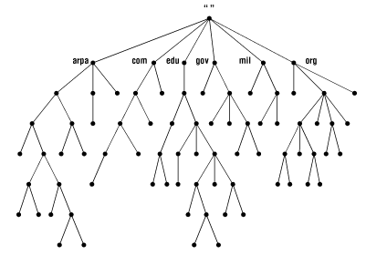
Name Server …
The depth of the tree is limited to 127 levels.
  Each node in the tree has a text label (without dots) that can be up to 63 characters long.
  A null (zero-length) label is reserved for the root.
  Domain names are always read from the node toward the root, with dots separating the names in the path.
  When the root node's label appears by itself, it is written as a single dot (.) for convenience.

Slide 10
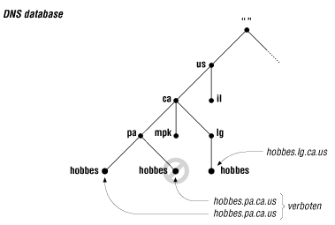
Name Server …
  DNS requires that sibling nodes have different labels.
  Restriction guarantees that a domain name uniquely identifies a single node in the tree.

Slide 11
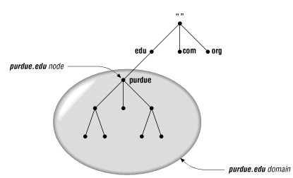
Name Server…
The domain name of a domain is the same as the domain name of the node at the very top of the domain.
So for example, the top of the purdue.edu domain is a node named purdue.edu

Slide 12
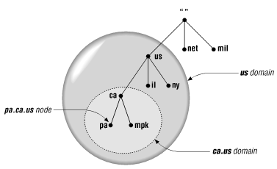
Name Server…
Any domain name in the subtree is considered a part of the domain.
Because a domain name can be in many subtrees, it can also be in many domains.
For example, the domain name pa.ca.us is part of the ca.us domain and also part of the us domain

Slide 13
Internet Domain Name Space
The original top-level domains divided the Internet domain name space organizationally into seven domains:
  com
    Commercial organizations, such as Hewlett-Packard (hp.com), Sun Microsystems (sun.com), and IBM (ibm.com).
  edu
    Educational organizations, such as Ambo University (ambou.edu) and Purdue University (purdue.edu).
  gov
    Government organizations, such as INSA (insa.gov) and the Ministry of Foreign Affairs (mfa.gov).
  mil
    Military organizations, such as the U.S. Army (army.mil ) and Navy (navy.mil ).
  net
    Organizations providing network infrastructure, such as EthioTelecom (ethiotelecom.net) and UUNET (uu.net).
  org
    Formerly, noncommercial organizations, such as the Electronic Frontier Foundation (eff.org ). Like net, however, restrictions on org were removed in 1996.
  int
    International organizations, such as NATO (nato.int).

Slide 14
Delegation
Decentralize administration in DNS is achieved through delegation.
  An organization administering a domain can divide it into subdomains.
  Each of those subdomains can be delegated to other organizations.
  An organization becomes responsible for maintaining all the data in that subdomain.
  It can freely change the data, and even divide up its subdomain into more subdomains and delegate those.

Slide 15
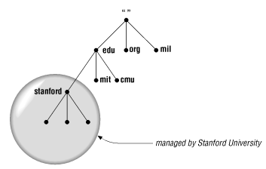
Delegation…
  Not all organizations delegate away their whole domain.
  A domain may have several delegated subdomains and also contain hosts that don't belong in the subdomains.
  For example, the Ambo University has a campus at Awaro and Woliso. So it might have a awaro.ambou.edu.et subdomain and a woliso.ambou.edu.et subdomain.

Slide 16
Name Servers and Zones
The programs that store information about the domain name space are called name servers.
Name servers generally have complete information about some part of the domain name space (a zone), which they load from a file or from another name server.
  The other name server is called Forwarder.
The name server is then said to have authority for that zone. Name servers can be authoritative for multiple zones, too.

Slide 17
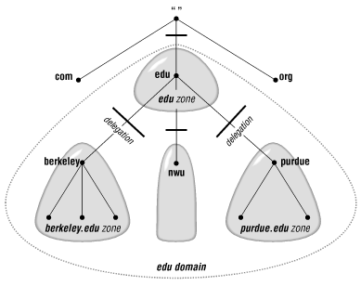
Zones…
All top-level domains, and many domains at the second level and lower, such as berkeley.edu and hp.com, are broken into smaller, more manageable units by delegation.
These units are called zones.

Slide 18
Zone Data Files
Most entries in zone data files are called DNS resource records.
DNS lookups are case-insensitive, so you can enter names in your zone data files in uppercase, lowercase, or mixed case.
  Commonly all lowercase is used.

Slide 19
Types of DNS Resource Records
SOA record
  Indicates authority for this zone (Start Of Authority)
NS record
  Lists a name server for this zone
A record
  Name-to-address mapping
PTR records
  Address-to-name mapping
CNAME records
  Canonical name (for aliases)
MX records
  Records for Mail Exchange server

Slide 20
Example
    ; ; NS Record;
    ambou.edu.et. IN NS ns1.ambou.edu.et
    ambou.edu.et. IN NS ns2.ambou.edu.et
    ;; Mail Exchange
    ambou.edu.et. IN MX mail.ambou.edu.et
    ;;A Records
    intranet.ambou.edu.et. IN A 10.5.100.9
    medsims.ambou.edu.et. IN A 10.5.100.56
    ; ; PTR Addresses
    9.100.5.102.in-addr.arpa. IN PTR intranet.ambou.edu.et. 56.100.5.10.in-addr.arpa. IN PTR medsims.ambou.edu.et
    ; ; Aliases
    medicine.ambou.edu.et. IN CNAME medsims.ambou.edu.et.

Slide 21
Resolver
Resolvers are the clients that access name servers. Programs running on a host that need information from the domain name space use the resolver.
The resolver handles the following tasks:
  Querying a name server
  Interpreting responses (which may be resource records or an error)
  Returning the information to the programs that requested it

Slide 22
Name Space Resolution
Name servers are adept at retrieving data from the domain name space.
They have to be, given the limited intelligence of most resolvers.
Not only can they give you data from zones for which they're authoritative, they can also search through the domain name space to find data for which they're not authoritative.
This process is called name resolution or simply resolution.

Slide 23
Resolution…
Because the namespace is structured as an inverted tree, a name server needs only one piece of information to find its way to any point in the tree:
  The domain names and addresses of the root name servers
  A name server can issue a query to a root name server for any domain name in the domain name space, and the root name server starts the name server on its way.

Slide 24
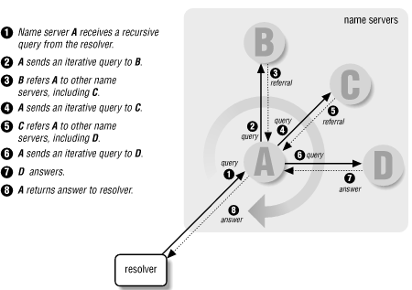
Resolution Process

Slide 25
Adding More Name Servers
Primary and Slave Name Servers
  In large networks it is a good idea to define name servers and give them authority.
    Primary Name Server is Authoritative
    Secondary Name Server is active when Primary NS fails
Caching Only Name Servers
  The name implies that the only function this server performs is looking up data and caching it.
  They are not authoritative for any zones (except 0.0.127.in-addr.arpa).

Slide 26
BIND
BIND (Berkeley Internet Name Domain) is the default name server for Linux OS.
Installation and Configuration:
  Update your server and Install BIND on it. Execute the following commands one by one.
    $sudo apt-get update
    $sudo apt-get install bind9 bind9utils bind9-doc
  Before proceeding you can optionally set bind9 to IPv4 mode.
    $sudo nano /etc/default/bind9
  Add "-4" to the OPTIONS variable. Then save and exit. It should look like the following:
    OPTIONS="-4 -u bind"

Slide 27
The End

