Slide 1



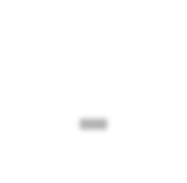
System and Network Administration
UNIT 2
User Management and Administration

Slide 2

Learning Objectives: At the end of the topic,
the students will be able to:
know the concepts of user management
understand the user registration, account policy and user support services
Create users and assign it to a group
Create User policy, rights and privilege
Demonstrate user and group registration and administration in Linux Server and Windows 2012 Server

Slide 3
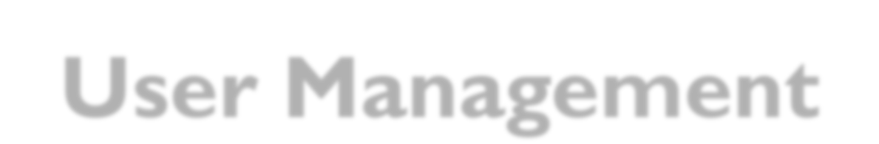

User Management
Without users, there would be few challenges in system
administration
. System administrators must cater to all needs, and
ensure the stability and security of the system.
From User Registration,Account Policy, controlling users
resources, etc.

Slide 4
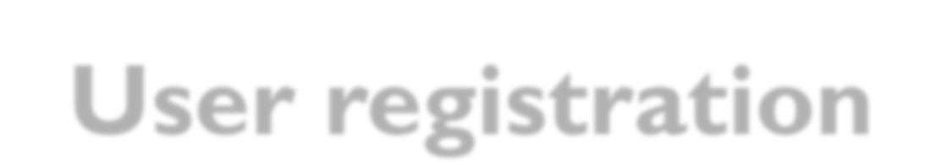

User registration
For small organizations, user registration is a relatively simple matter.
Users can be registered at a centralized location by the system manager, and made available to all of the hosts in the network by some sharing mechanism, such as a login server, distributed authentication service or by direct copying of the data.
For larger organizations, with many departments, user registration is much more complicated.The need for centralization is often in conflict with the need for delegation of responsibility.
It is convenient for autonomous departments to be able to register their own users, but it is also important for all users to be registered under the umbrella of the organization, to ensure unique identities for the users and flexibility of access to different parts of the organization.


Slide 5
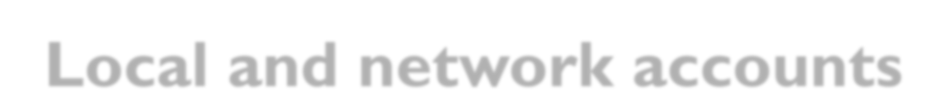

Local and network accounts
With a local account, a user has permission to use
only the local host.
With a network account, the user can use any host
which belongs to a network domain.
They will need access to system resources wherever they are. It follows that they need distributed accounts.

Slide 6


Account policy
Most organizations need a strict policy for assigning
accounts and opening thesystem for users.
Users are the foremost danger to a computing system, so theresponsibility of owning an account should not be dealt out lightly

Slide 7

Account policy
What should an account policy contain?
Rules about what users are allowed/not allowed to do.
Specifications of what mandatory enforcement users can expect, e.g. tidying of garbage files.
Any account policy should contain a clause about weak passwords. If weak passwords are discovered, it must be understood by users that their account can be closed immediately.

Slide 8
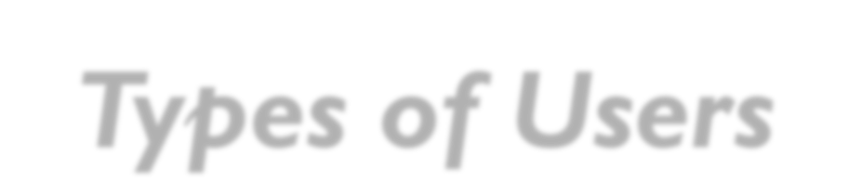

Types of Users
Passive users utilize the system often minimally, quietly accepting the choices which have been made for them.
Active users, on the other hand, follow every detail of system development.They frequently find every error in the system and contact system administratorsfrequently, demanding upgrades of their favorite programs

Slide 9
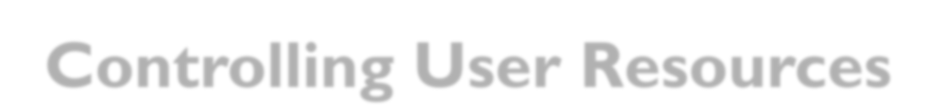

Controlling User Resources
Disk quotas: Place fixed limits on the amount of disk space which can beused per user.The advantage of this is that the user cannot use more storagethan this limit
CPU time limit: Some faulty software packages leave processes running whichconsume valuable CPU cycles to no purpose.
Policy decisions: Users collect garbage.To limit the amount of it, one canspecify a system policy which includes items of the form

Slide 10

Moving and Deleting Users
When disk partitions become full, it is necessary to move users from old partitionsto new ones. Moving users is a straightforward operation, but it should be donewith some caution.A user who is being moved should not be logged in while themove is taking place, or files could be copied incorrectly.
Users who leave an organization eventually need to be deleted from the system.For the sake of certainty, it is often advisable to keep old accounts for a timein case the user actually returns, or wishes to transfer data to a new location

Slide 11

Moving and Deleting Users
Then we have to remove the following:
Account entry from the password database.
Personal files.
E-mail and voice mail and mailing lists.
Removal from groups and lists (e.g. mailing lists).
Revocation of smartcards and electronic ID codes

Slide 12


Computer usage policy
Let us formulate a generic policy for computer users, the like of which one might expect company employees to agree to
Information Technology Policy Documents are becoming more widely used.Their practice has to be recommended, if only to make it clear to everyone involved what is considered acceptable behavior. Such documents could save organization sreal money in law-suits.The policy should include:
What all parties should do in case of dismissal
What all parties should do in case of security breach
What are users’ responsibilities to their organization?
What are the organization’s responsibilities to their users?

Slide 13
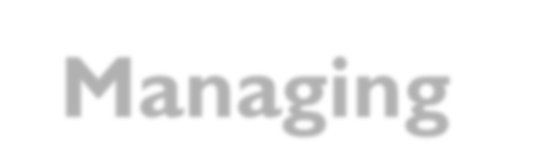
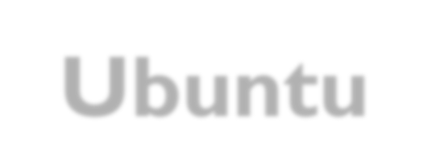
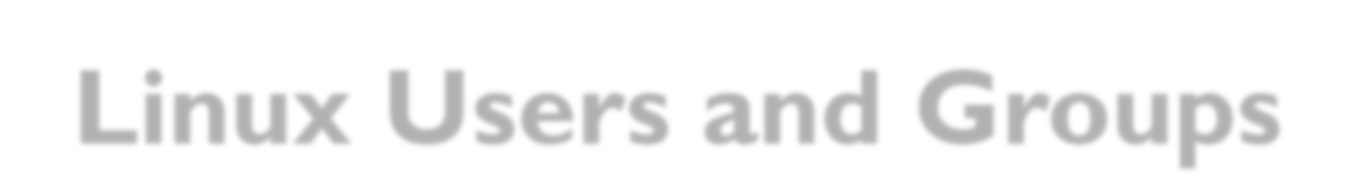

Managing Ubuntu Linux Users and Groups
Adding a User to an Ubuntu Linux System
Deleting a User from an Ubuntu Linux System
Adding a New Group to an Ubuntu Linux System
Deleting a Group from an Ubuntu Linux System

Slide 14
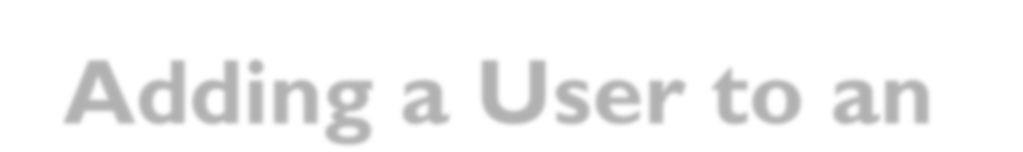
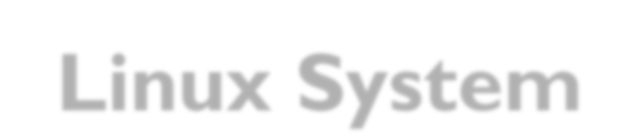

Adding a User to an Ubuntu Linux System
Create a user and its home directory
Sudo adduser --home /home/habtamu habtamu

Slide 15
Adding a User to an Ubuntu Linux System
Create a user
Sudo adduser habtamu
Create a user and its home directory
Sudo adduser --home /home/habtamu habtamu

Slide 16

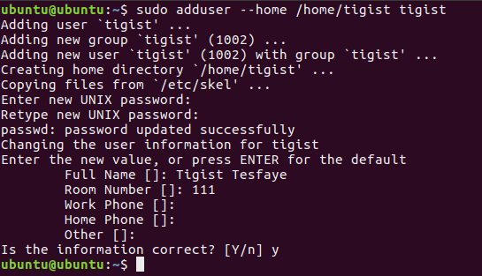
Adding a User to an Ubuntu Linux System
Create a user and its home directory
Sudo adduser --home /home/habtamu habtamu

Slide 17
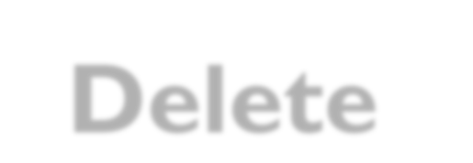
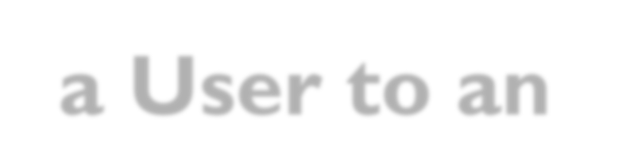

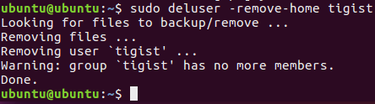
Delete a User to an Ubuntu Linux System
Delete a user and its home directory
Sudo deluser –remove-home tigist

Slide 18
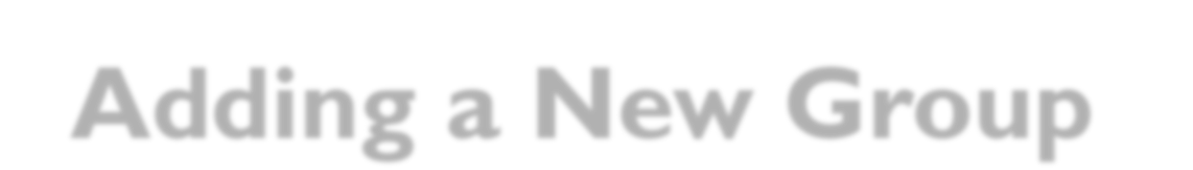
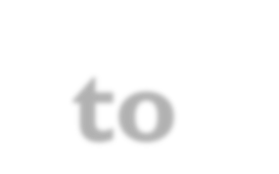
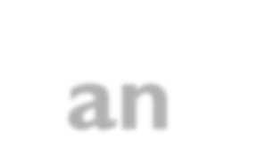
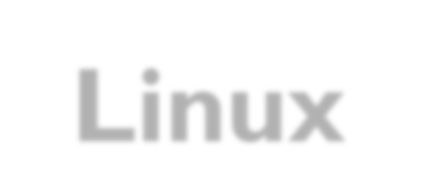
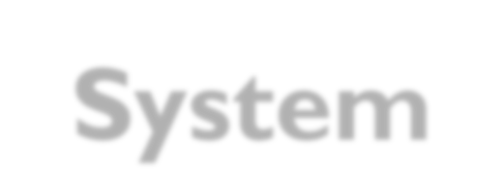

Adding a New Group to an Ubuntu Linux
System
Add Group:
Sudo addgroup masters
Add User to Group:
Sudo addgroup tigist masters

Slide 19
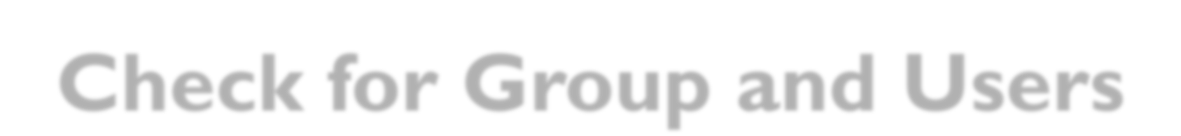

Check for Group and Users
Check Users:
Sudo Compgen -u
Check Groups:
Sudo Getent group

Slide 20
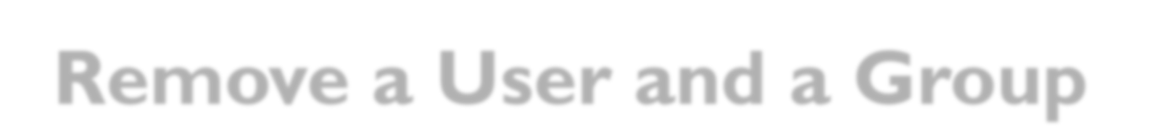
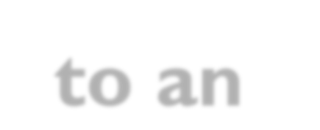
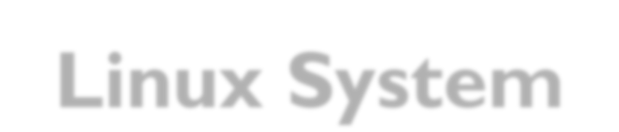
Remove a User and a Group to an Ubuntu
Linux System
Remove Users in a group:
Sudo deluser tigist masters
Remove Groups:
Sudo delgroup masters

